Slide 1
Data Structures

Slide 2
Objectives
In this chapter, you will learn:
To be able to allocate and free memory dynamically for data objects.
To be able to form linked data structures using pointers, self-referential structures and recursion.
To be able to create and manipulate linked lists, queues, stacks and binary trees.
To understand various important applications of linked data structures.

Slide 3
Dynamic data structures
Data structures that grow and shrink during execution
Linked lists
collections of data items “lined up in a row”
Allow insertions and removals anywhere
Stacks
Allow insertions and removals only at top of stack
important in compilers and operating systems
Queues
represent waiting lines;
Allow insertions at the back and removals from the front
Binary trees
High-speed searching and sorting of data and efficient elimination of duplicate data items

Slide 4
Self-Referential Structures
Self-referential structures
Structure that contains a pointer to a structure of the same type
Can be linked together to form useful data structures such as lists, queues, stacks and trees
Terminated with a NULL pointer (0)
struct node { int data; struct node *nextPtr; }
nextPtr
Points to an object of type node
Referred to as a link
Ties one node to another node

Slide 5
Self Referential Classes
15
10
Data member and pointer
NULL pointer (points to nothing)

Slide 6
Dynamic Memory Allocation
Dynamic memory allocation
Obtain and release memory during execution
malloc
Takes number of bytes to allocate
Use sizeof to determine the size of an object
Returns pointer of type void *
A void * pointer may be assigned to any pointer
If no memory available, returns NULL
Example
newPtr = malloc( sizeof( struct node ) );
free
Deallocates memory allocated by malloc
Takes a pointer as an argument
free ( newPtr );
C also provides functions calloc and realloc for creating and modifying dynamic arrays.

Slide 7
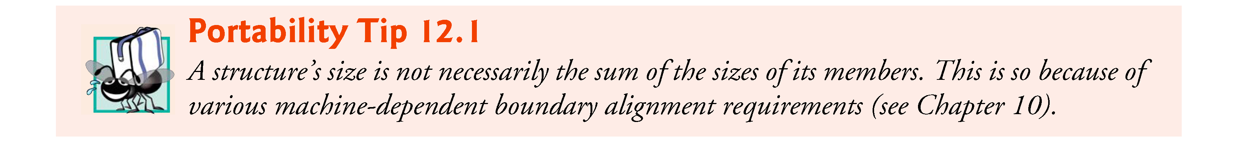

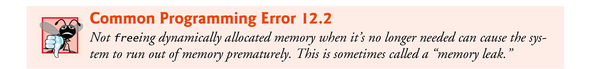
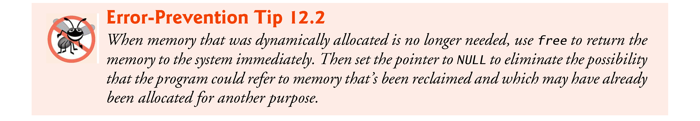
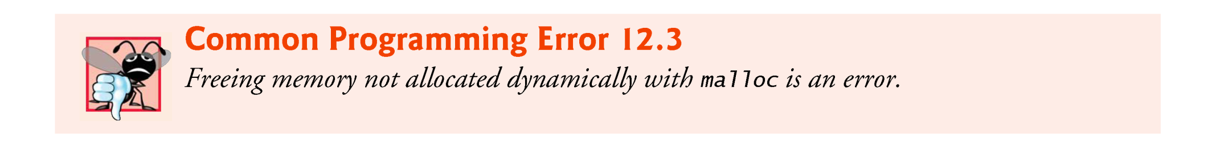
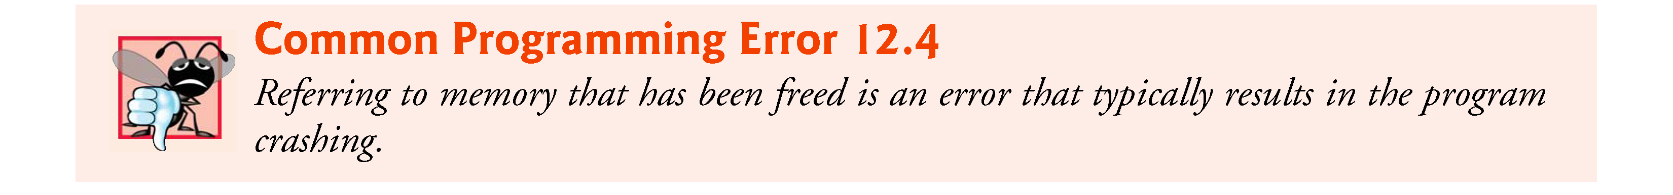

Slide 8
Linked Lists
Linked list
Linear collection of self-referential class objects, called nodes
Connected by pointer links
Accessed via a pointer to the first node of the list
Subsequent nodes are accessed via the link-pointer member of the current node
Link pointer in the last node is set to NULL to mark the list’s end
Use a linked list instead of an array when
You have an unpredictable number of data elements
Your list needs to be sorted quickly

Slide 9
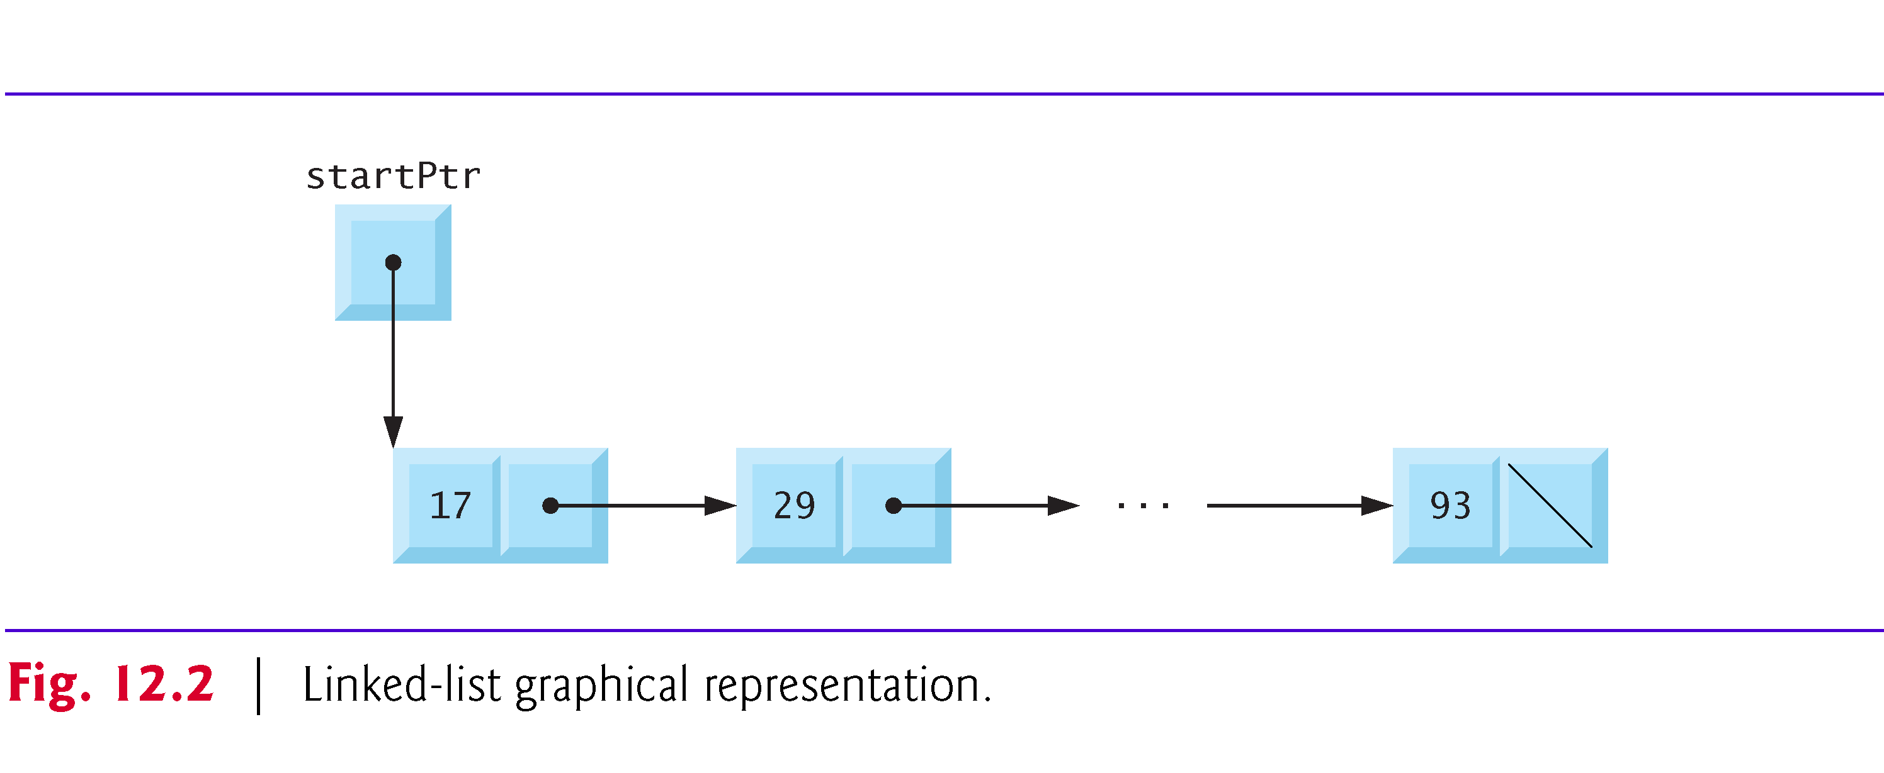
Linked Lists

Slide 10
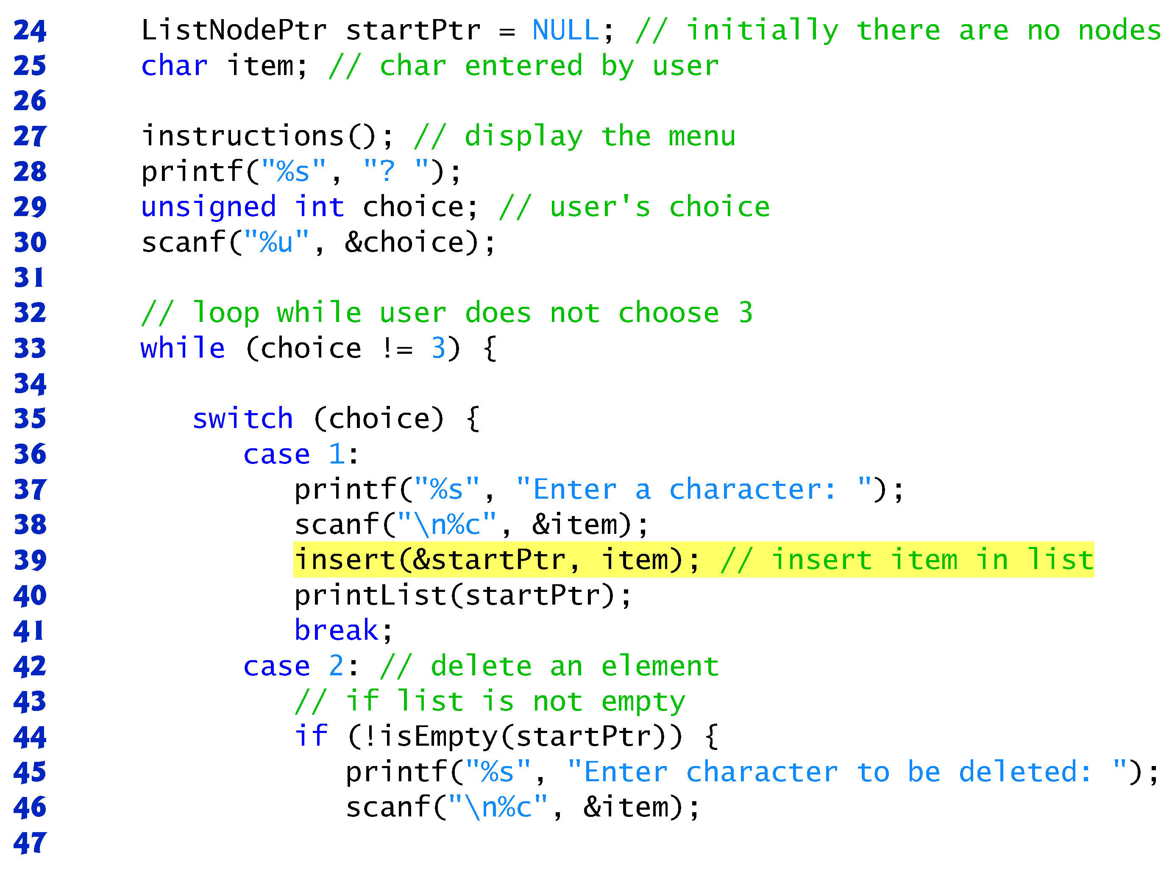
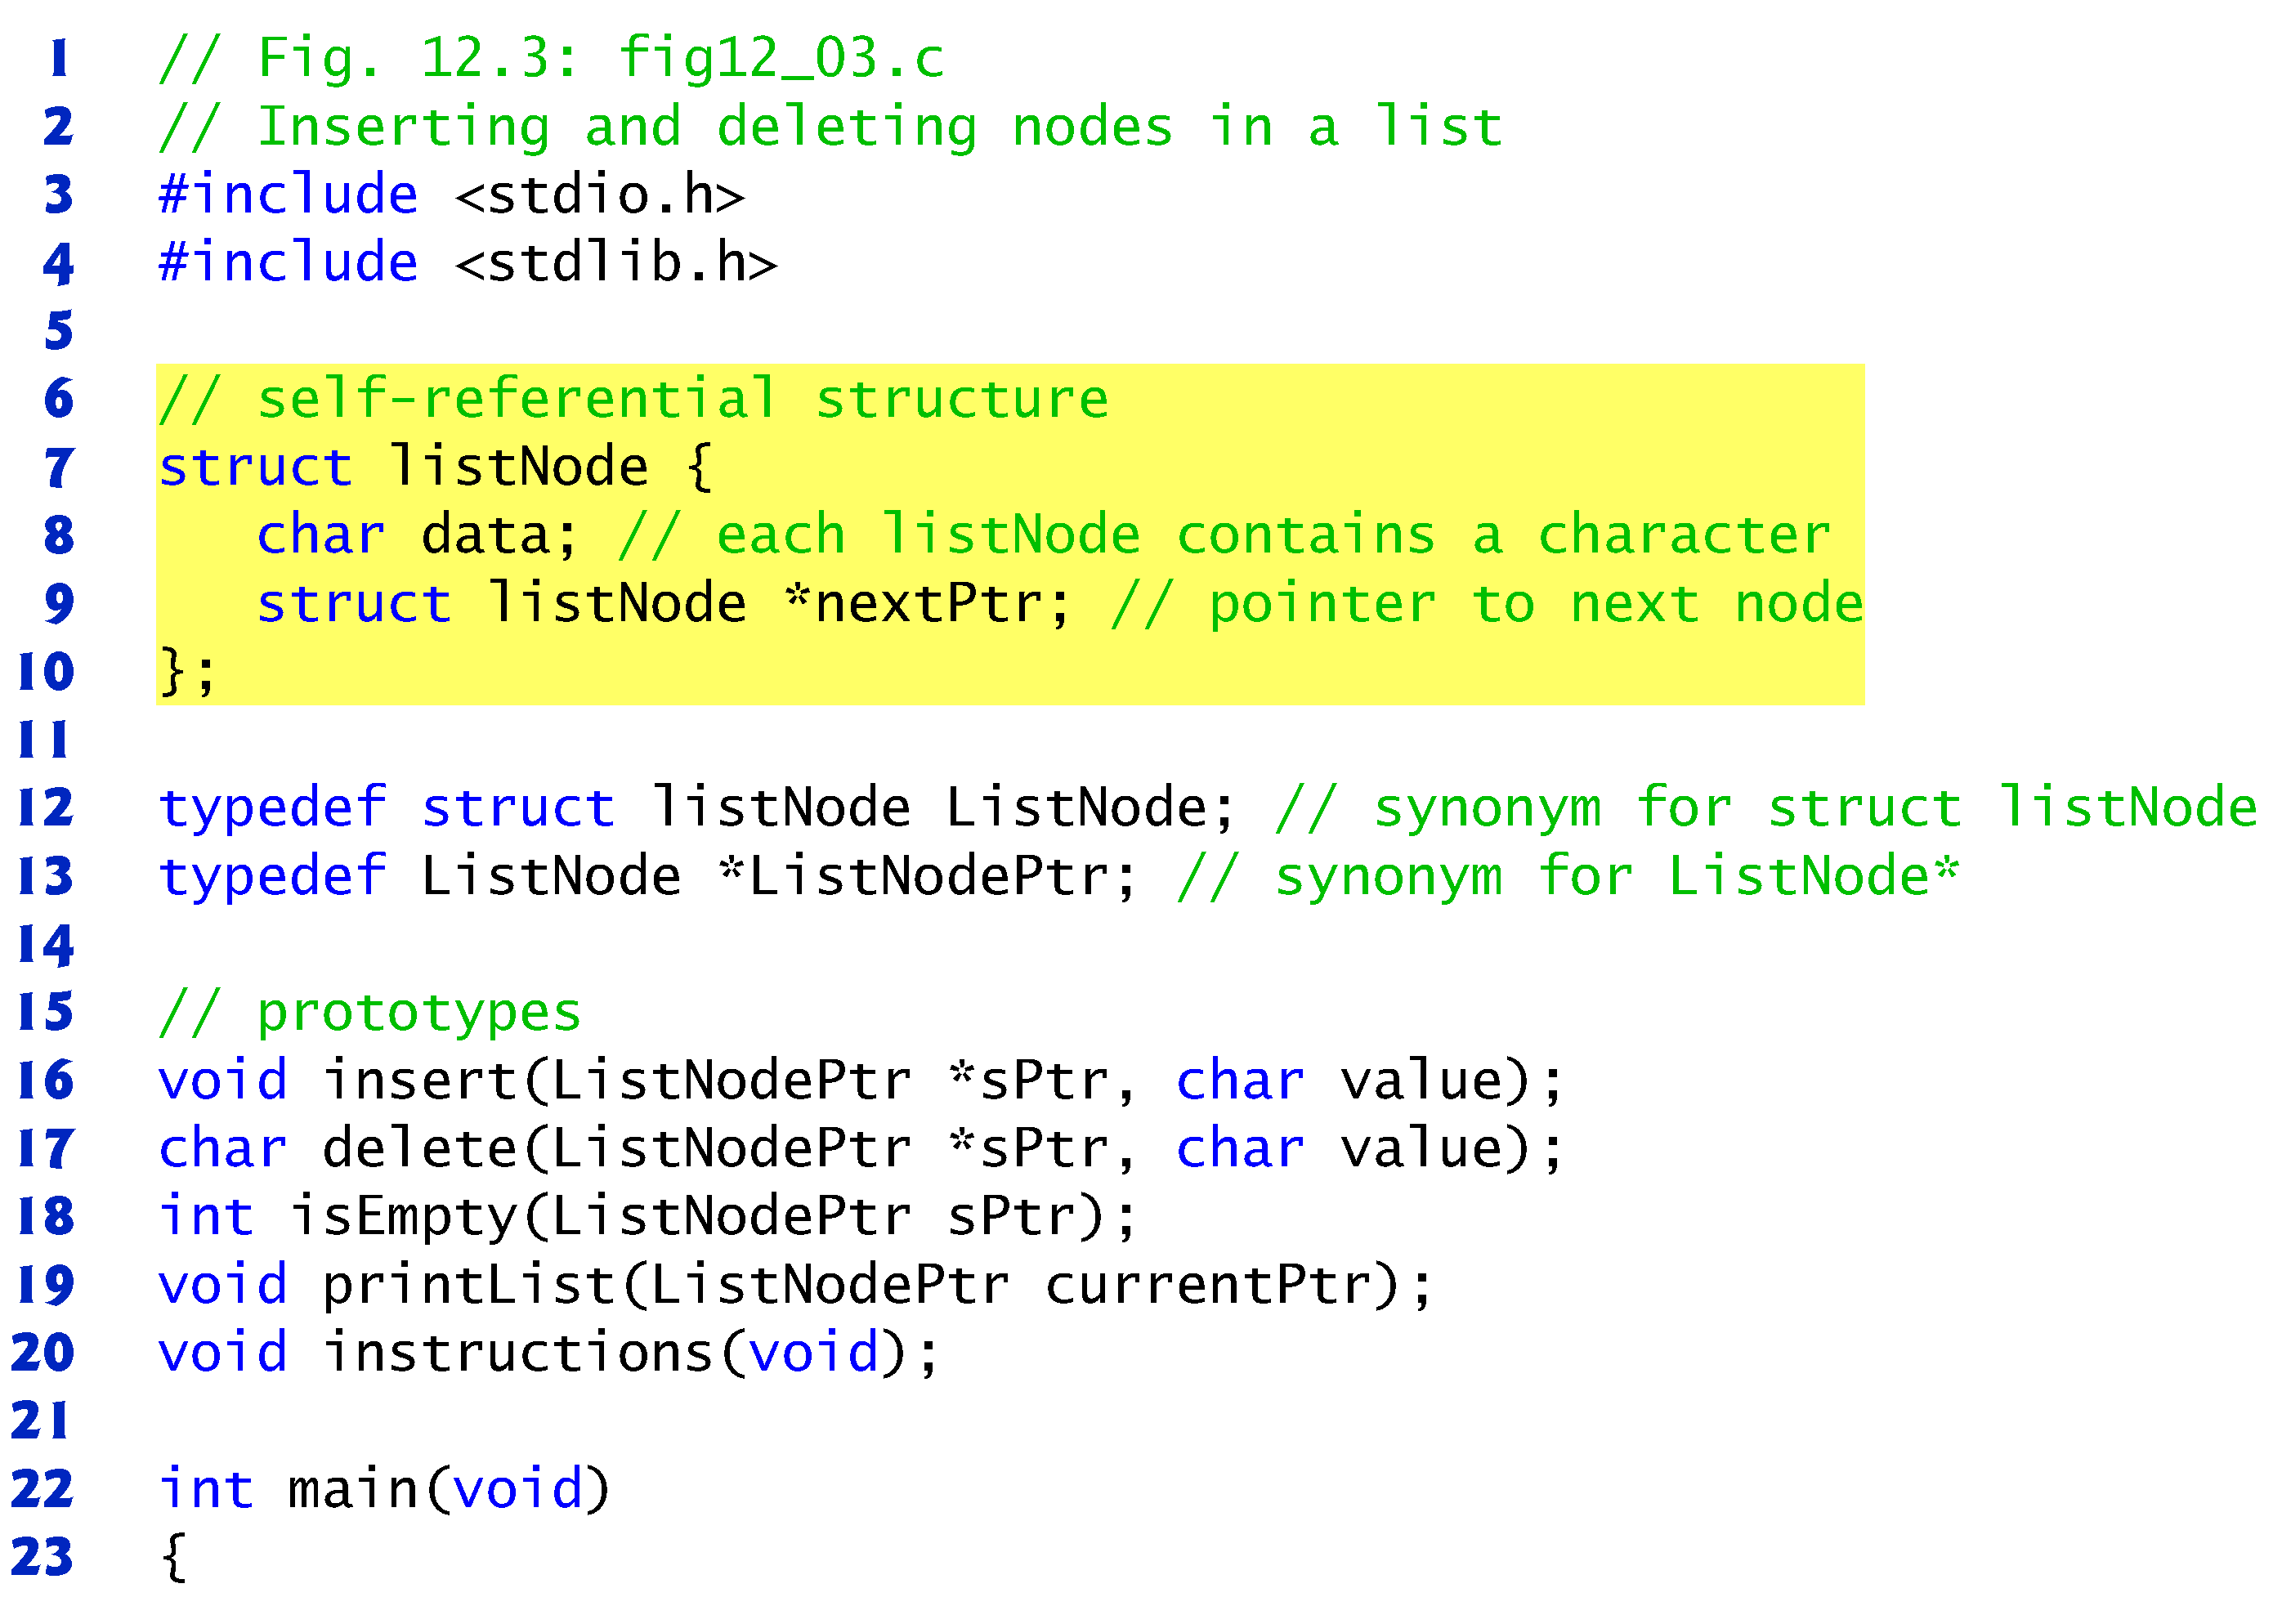

Slide 11
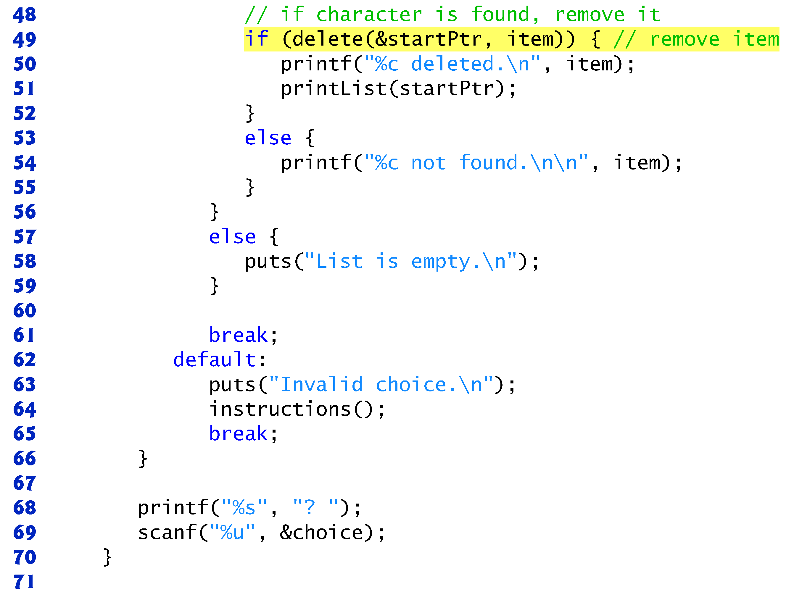
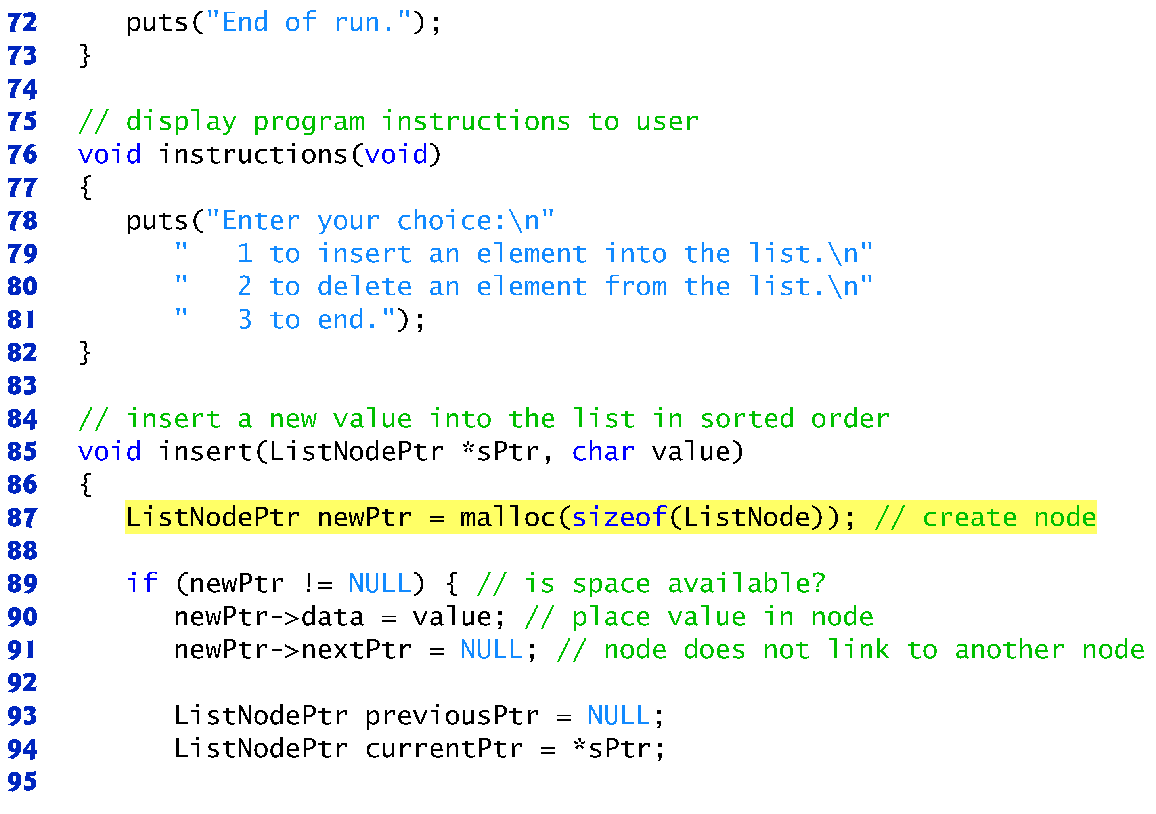

Slide 12
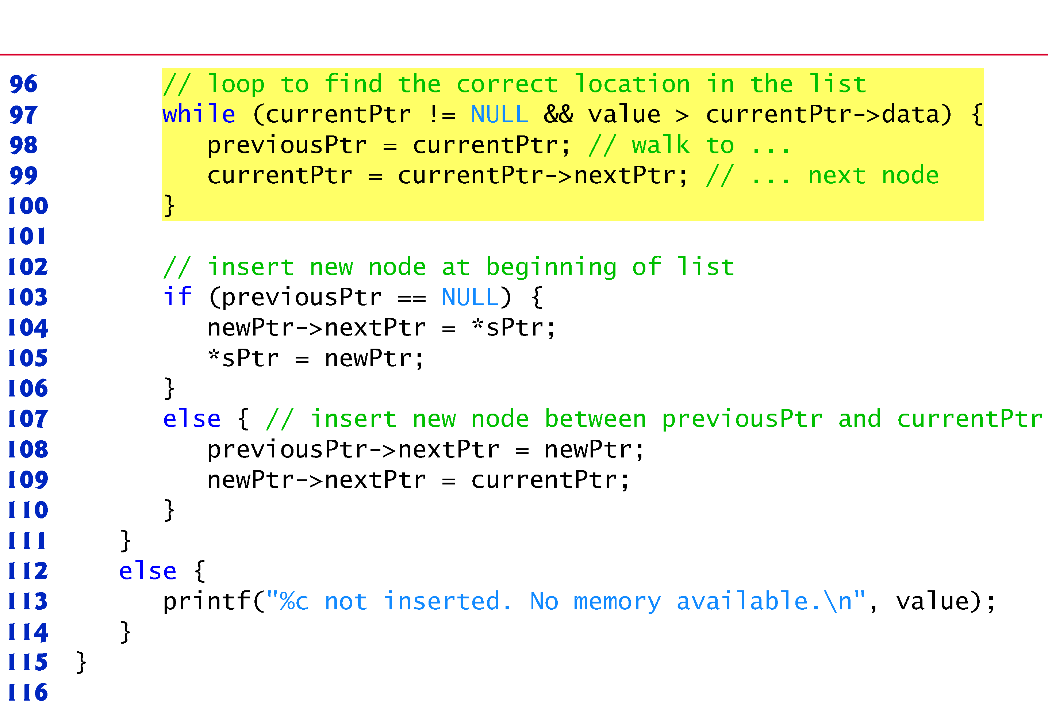
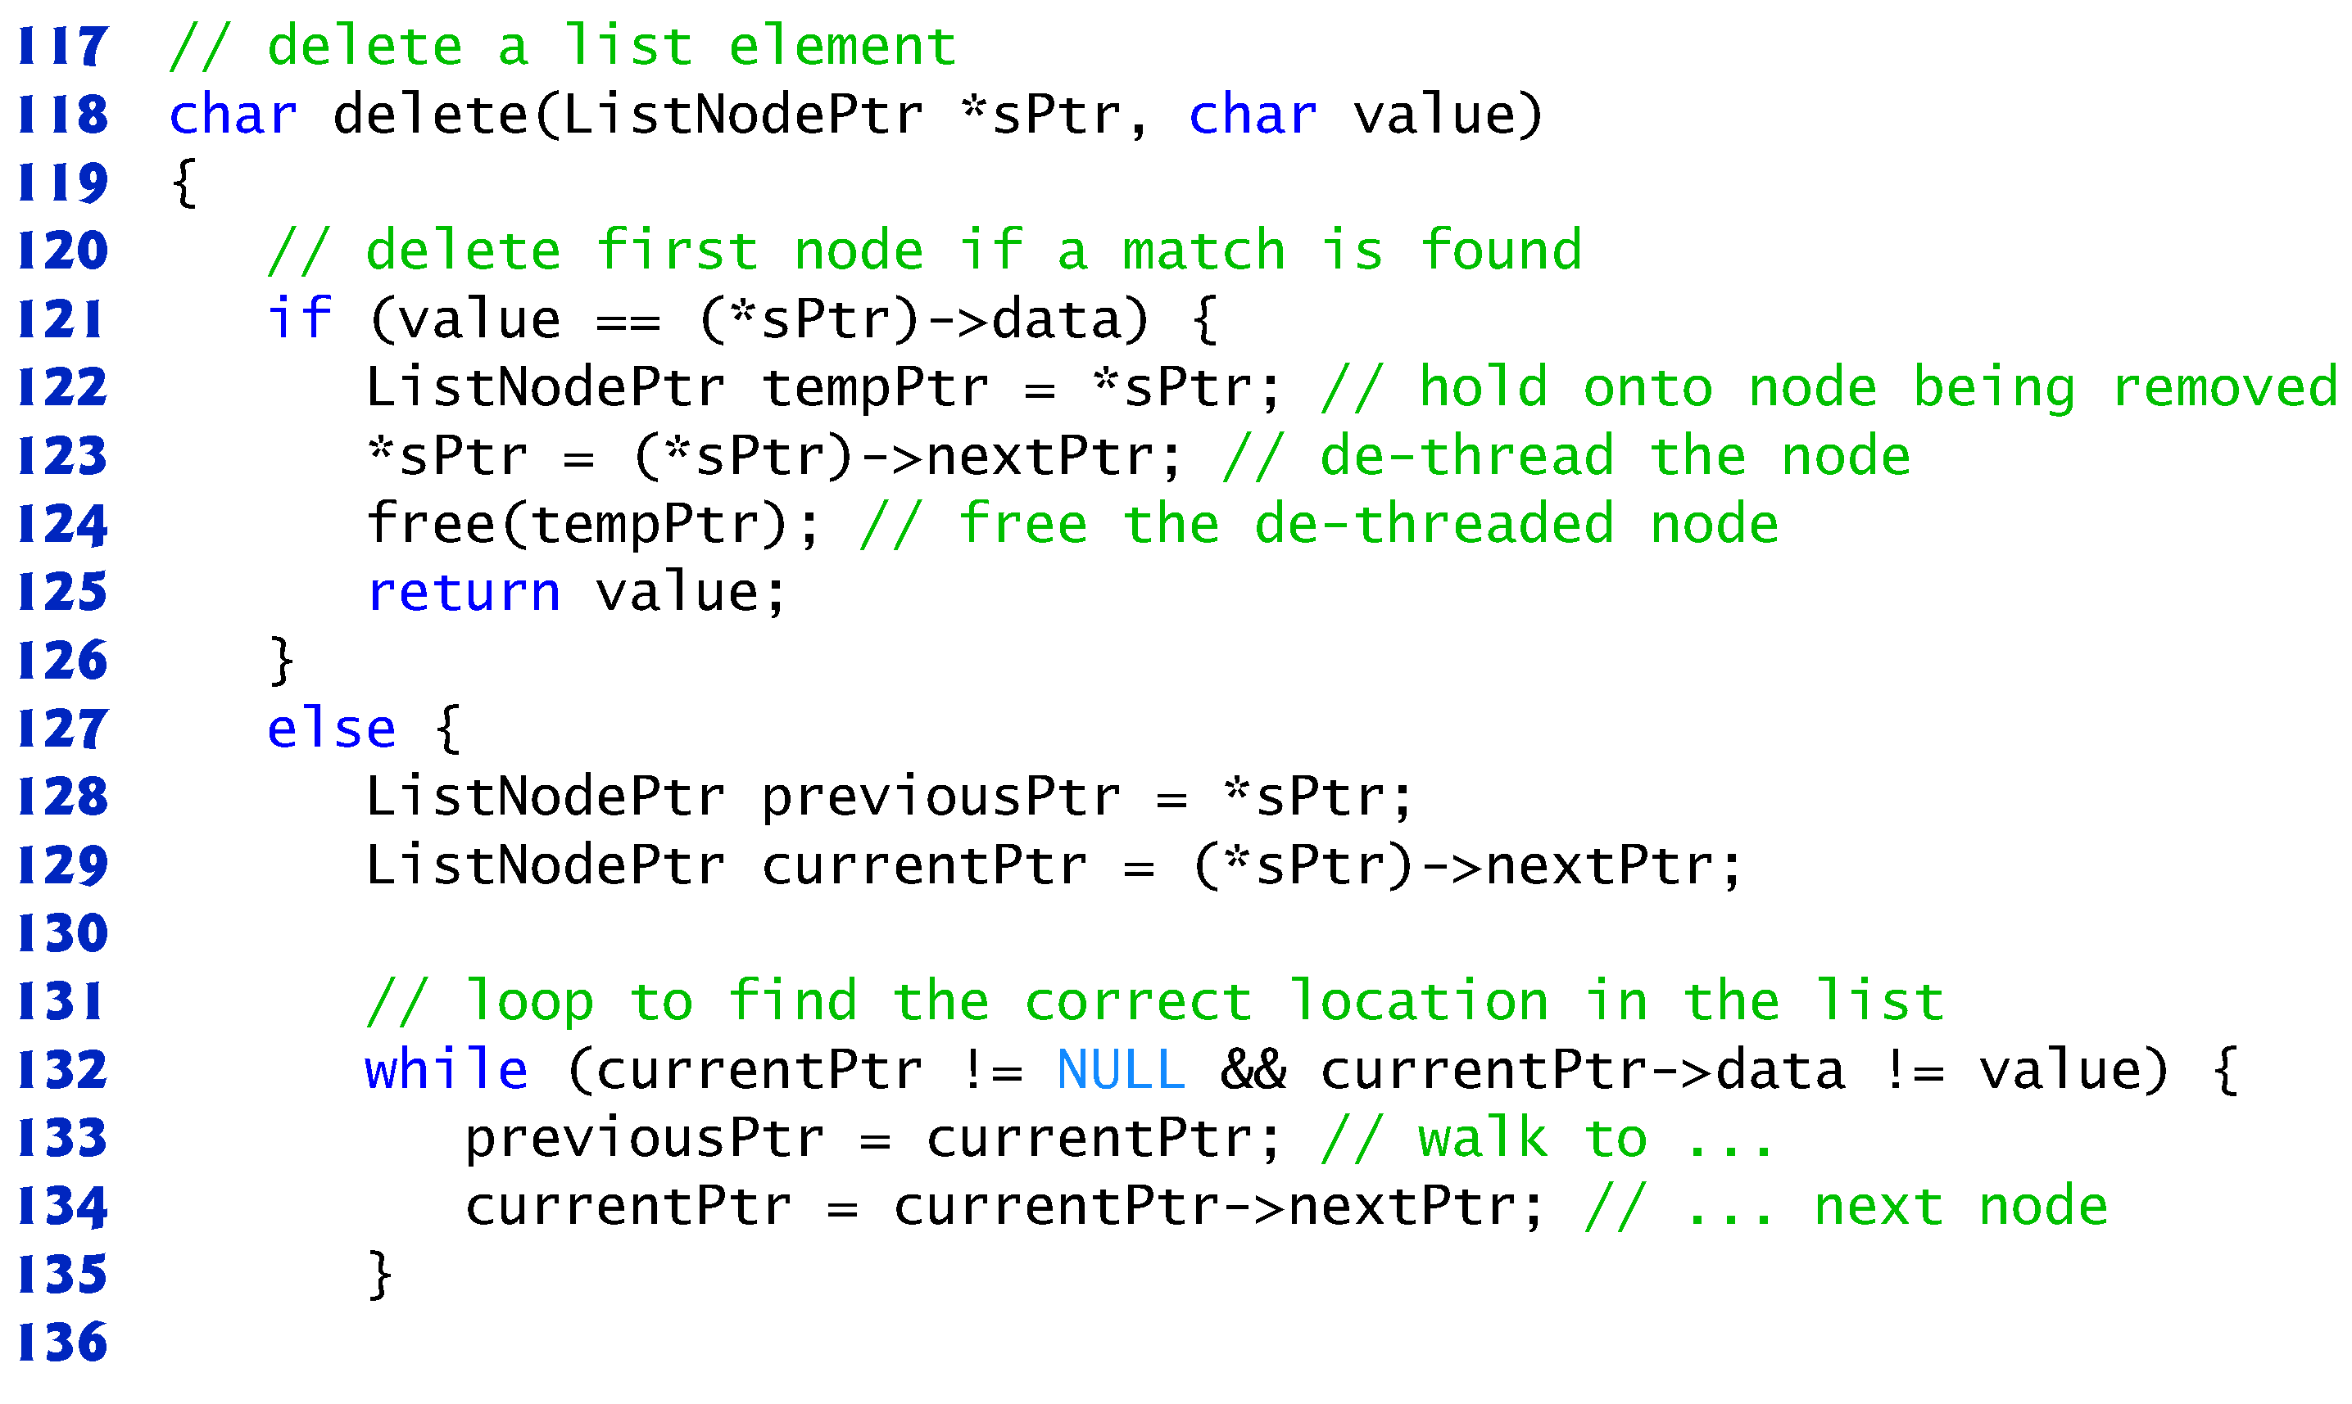

Slide 13
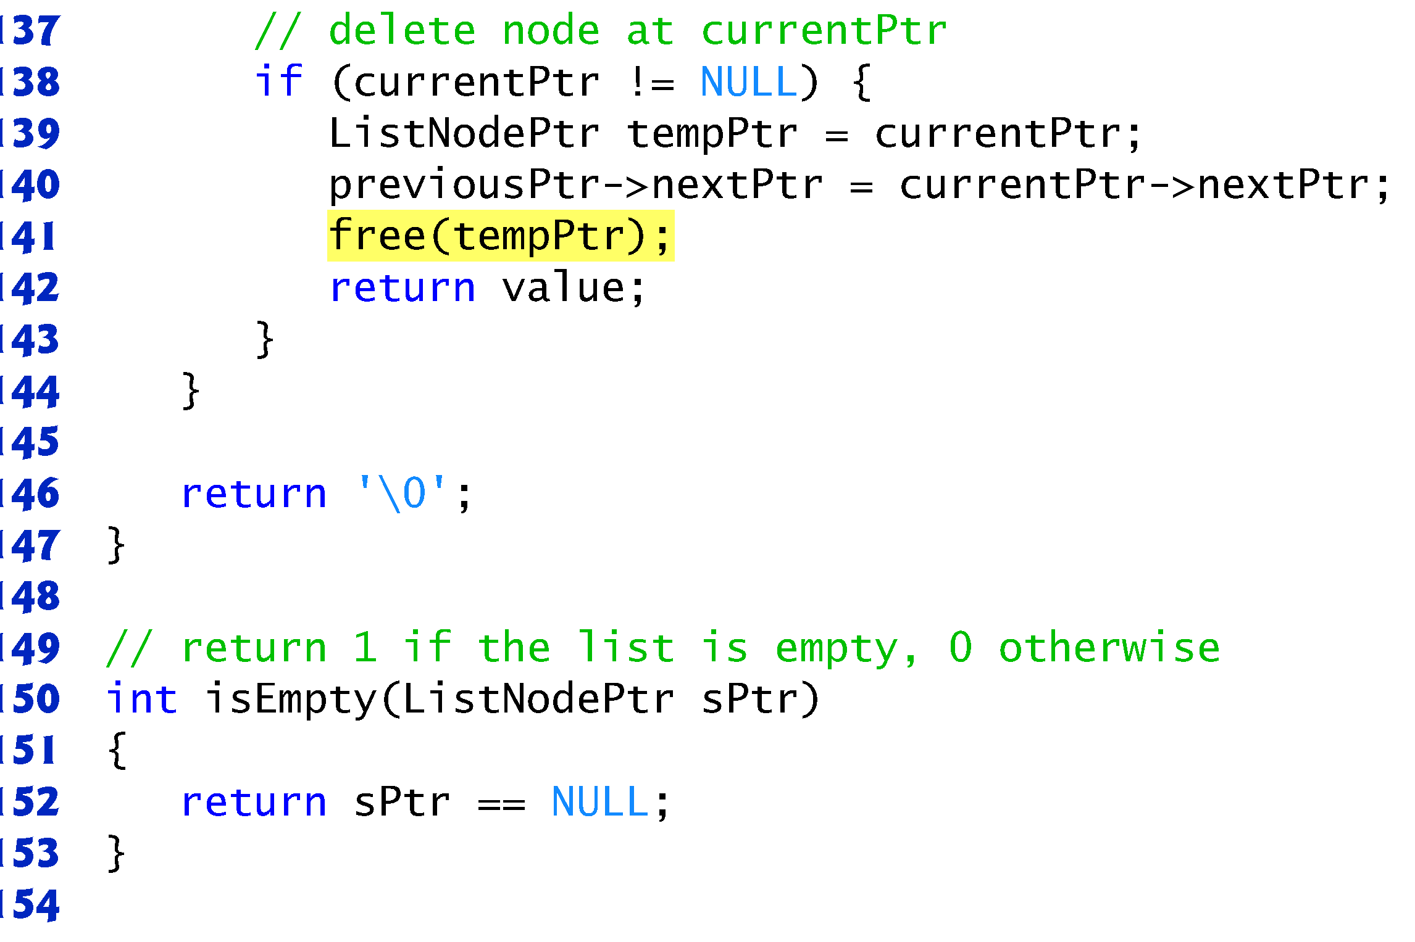
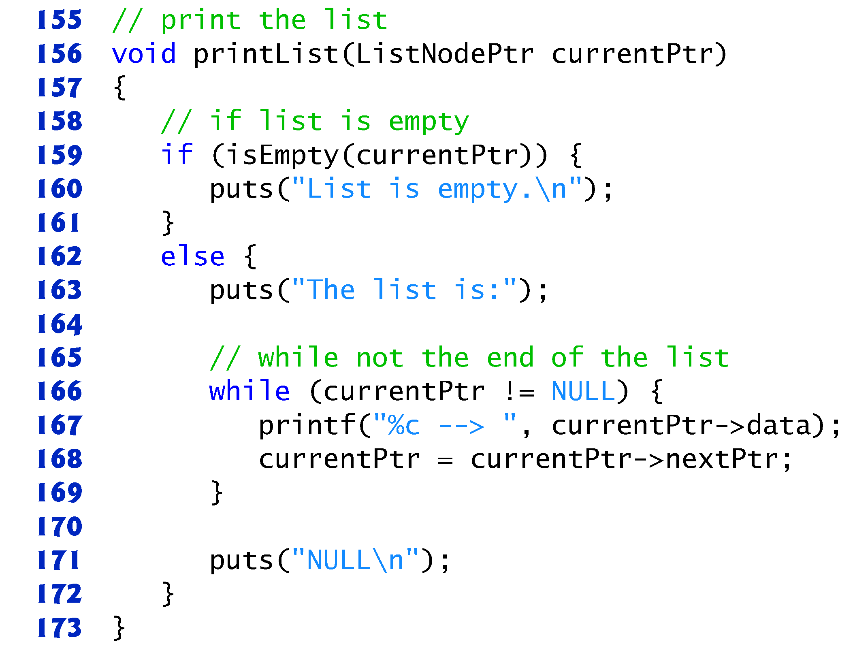

Slide 14
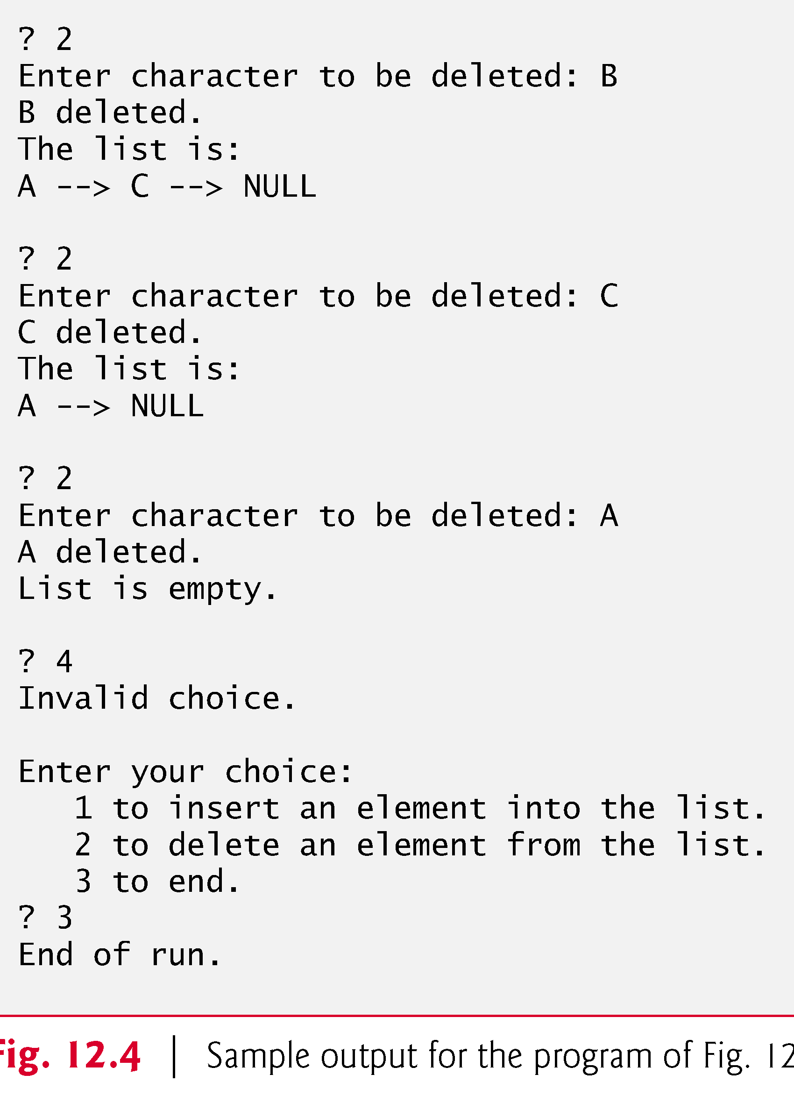
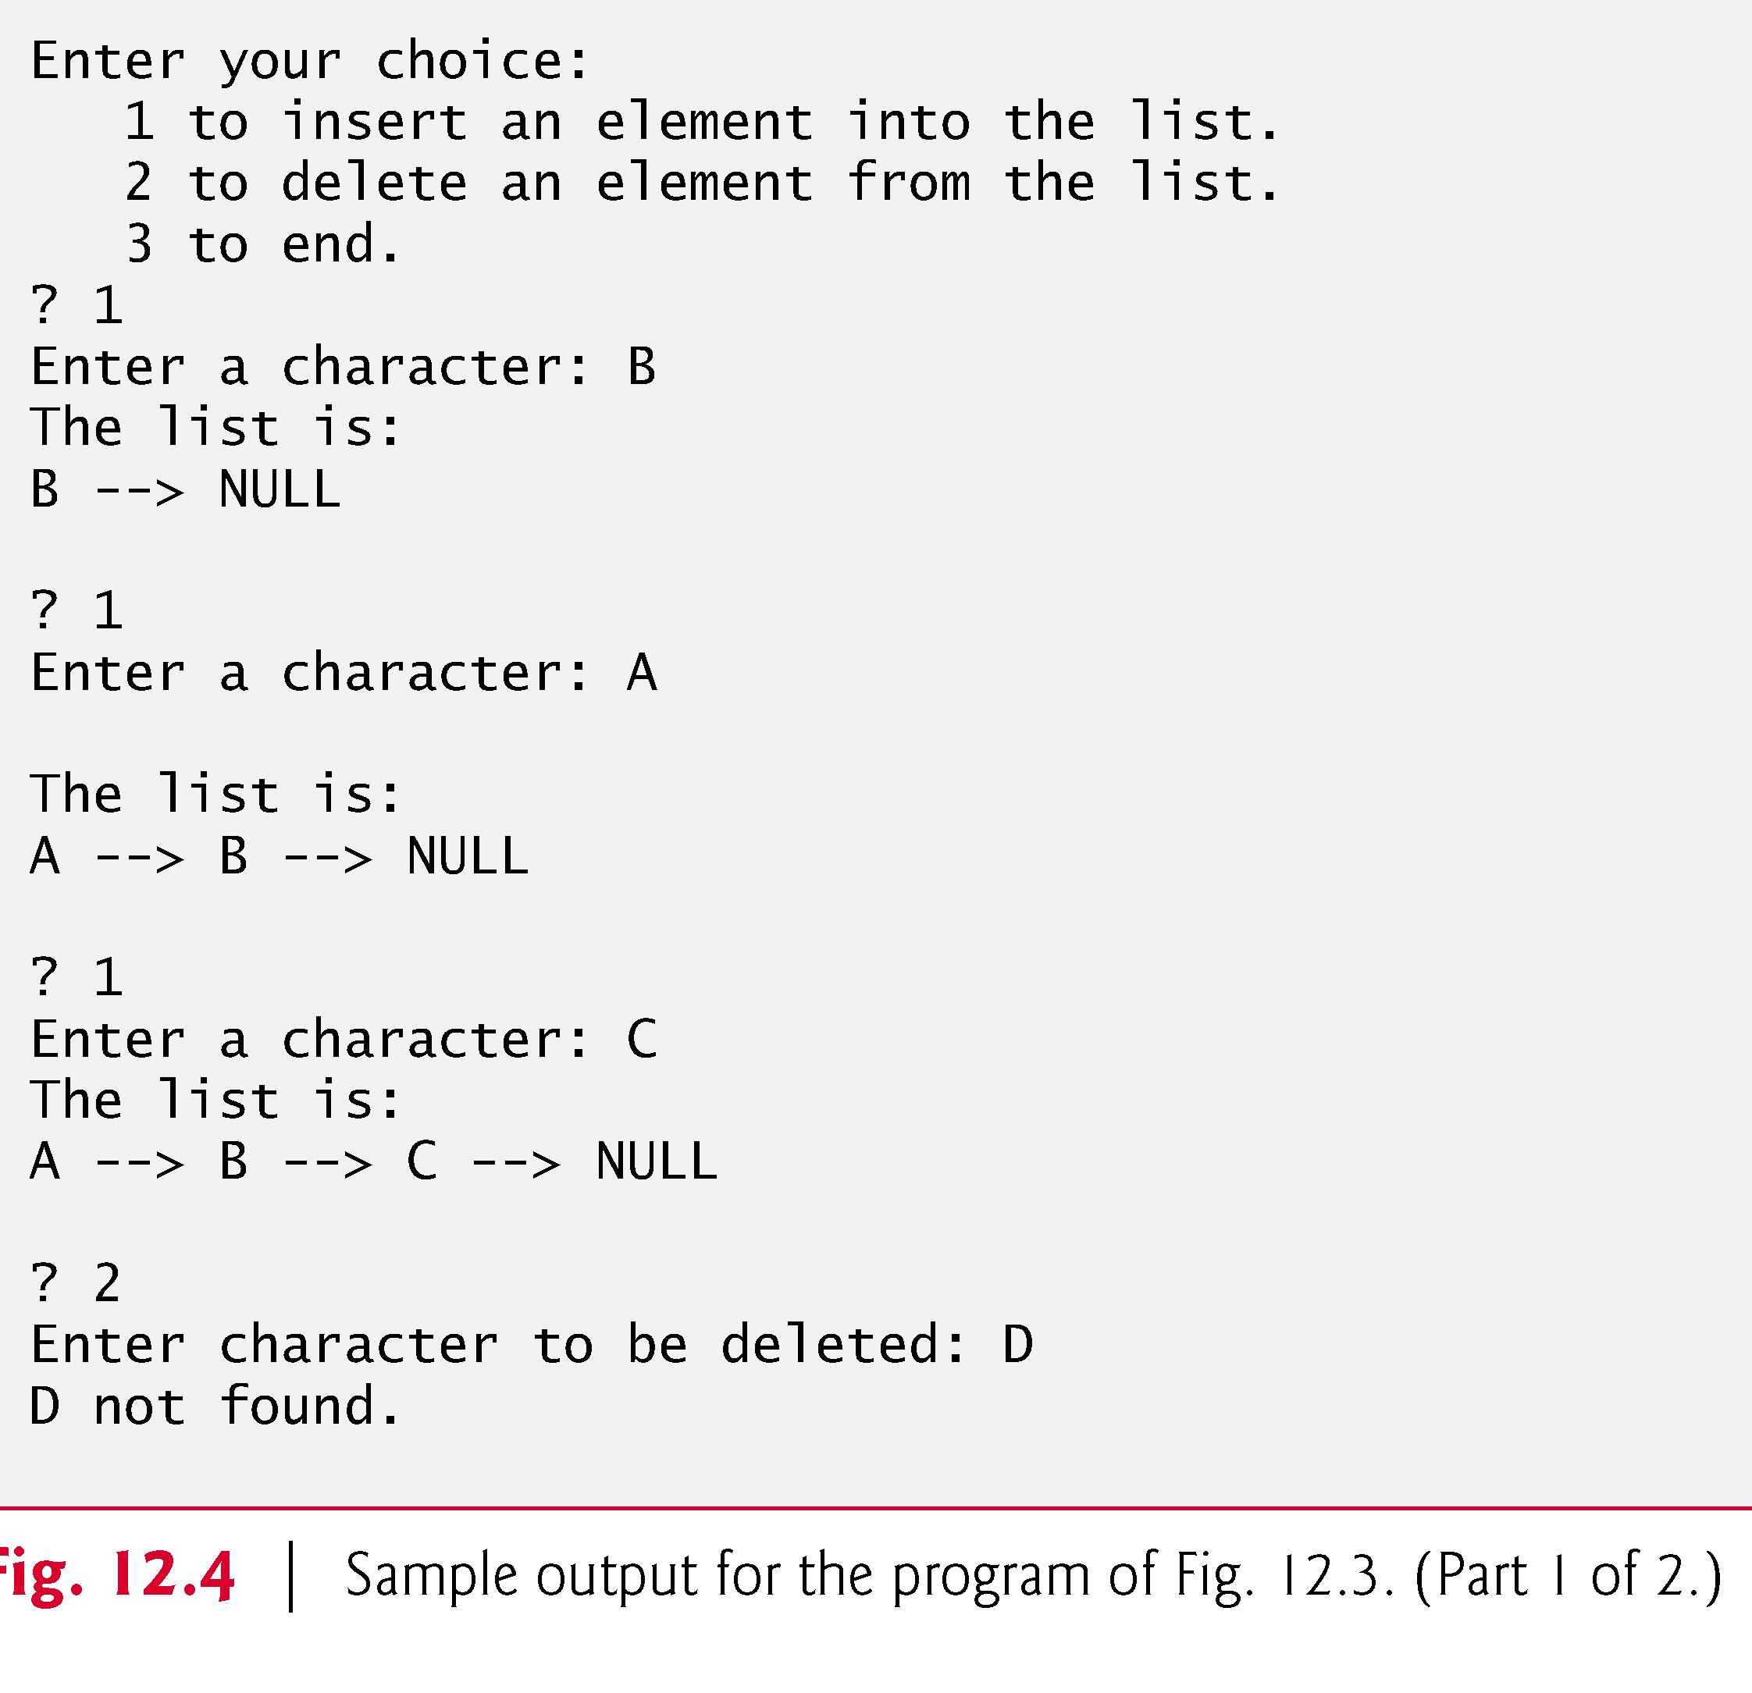

Slide 15
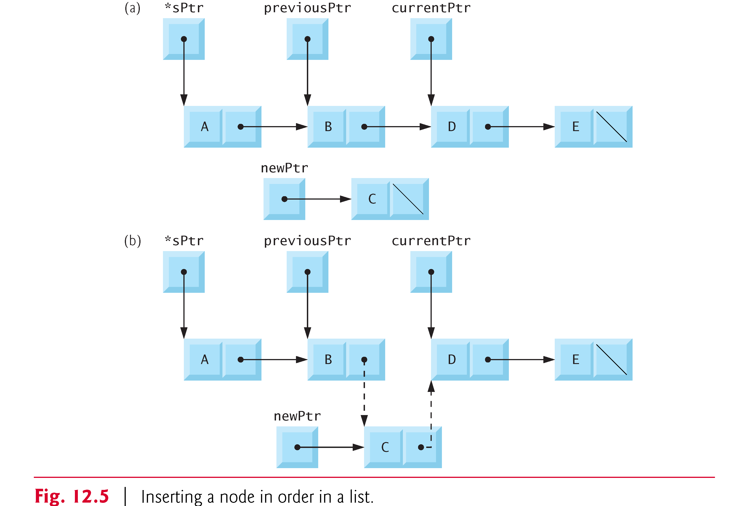
Linked Lists

Slide 16
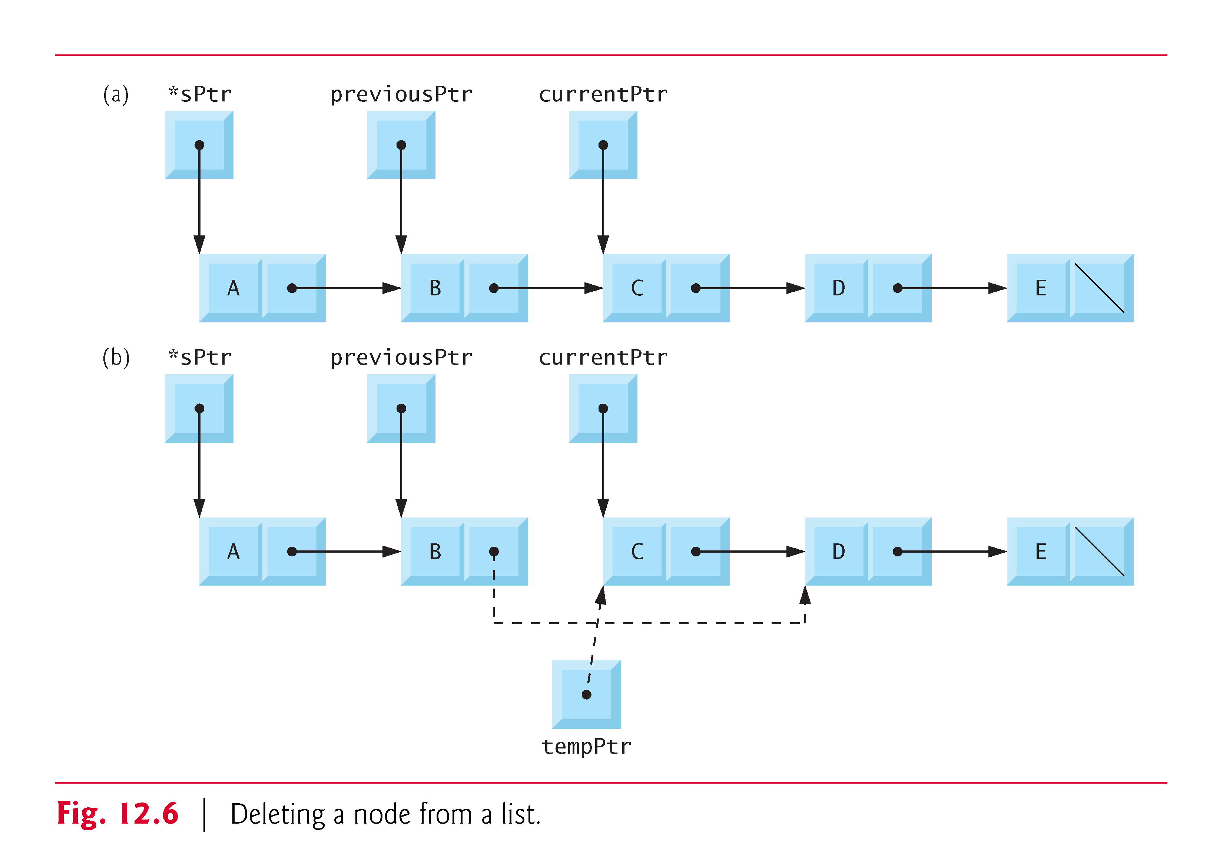

Slide 17
Linked Lists (Cont.)
Types of linked lists:
Singly linked list
Begins with a pointer to the first node
Terminates with a null pointer
Only traversed in one direction
Circular, singly linked
Pointer in the last node points back to the first node
Doubly linked list
Two “start pointers” – first element and last element
Each node has a forward pointer and a backward pointer
Allows traversals both forwards and backwards
Circular, doubly linked list
Forward pointer of the last node points to the first node and backward pointer of the first node points to the last node

Slide 18
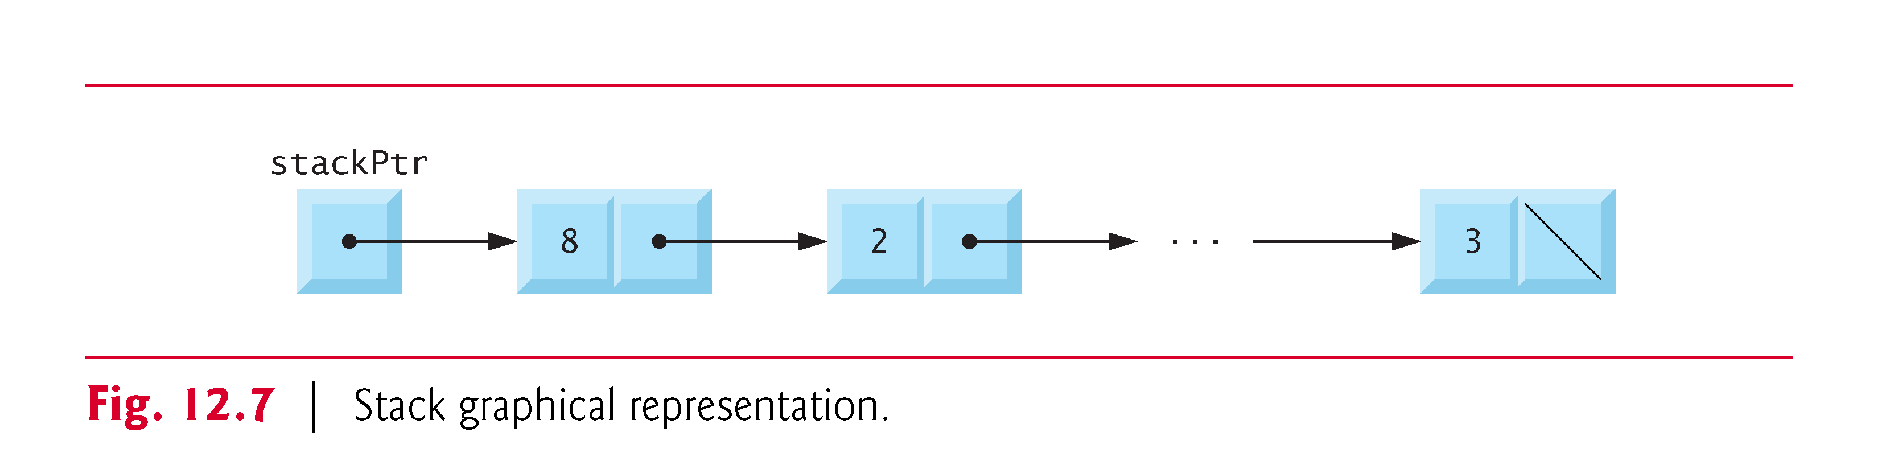
Stacks

Slide 19
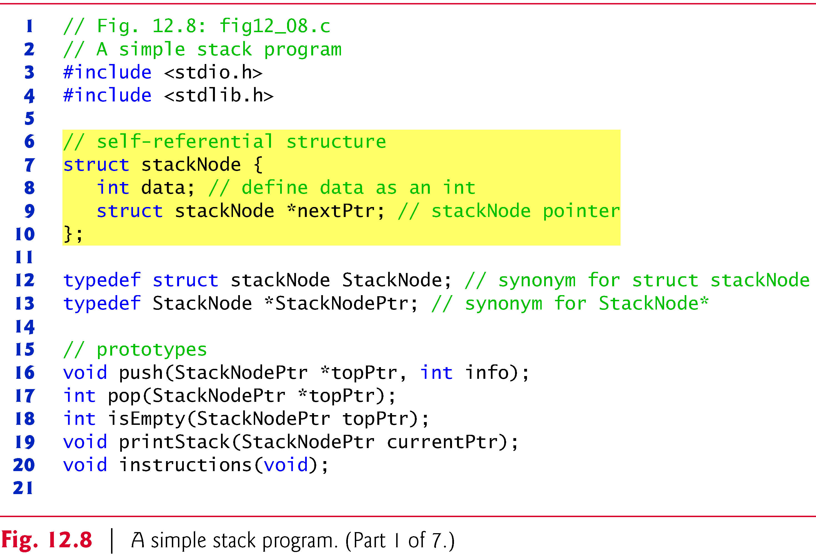
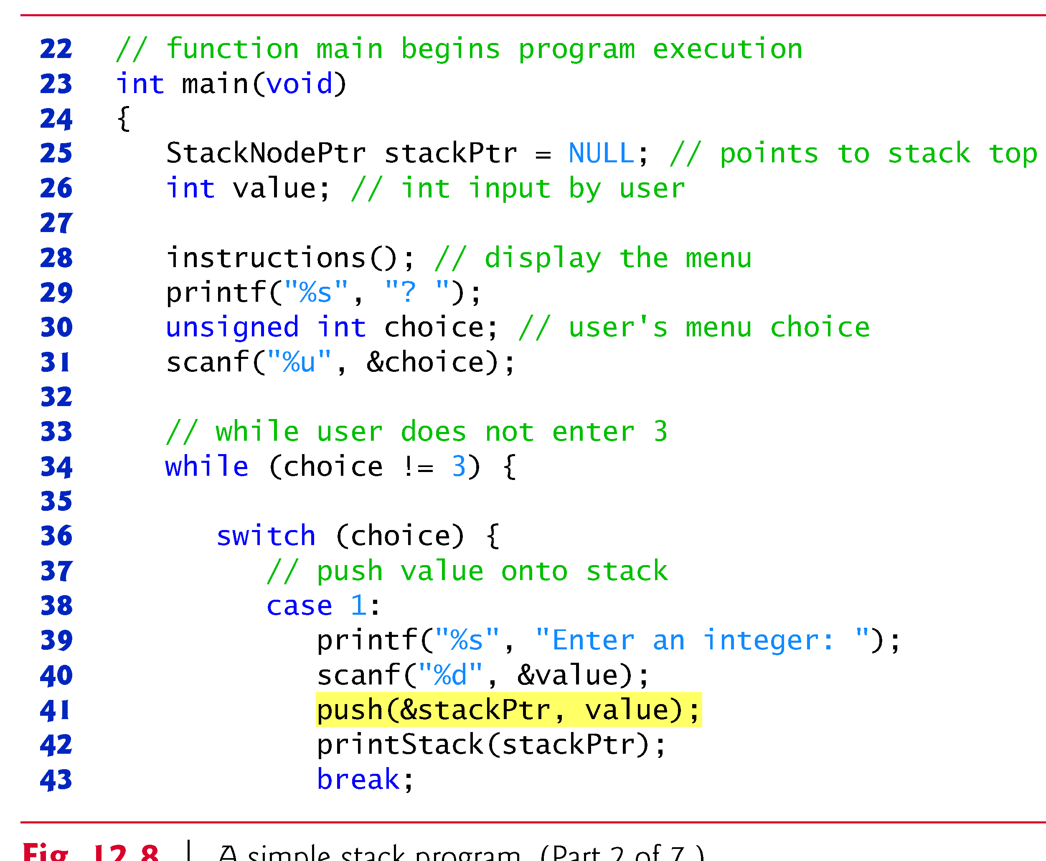

Slide 20
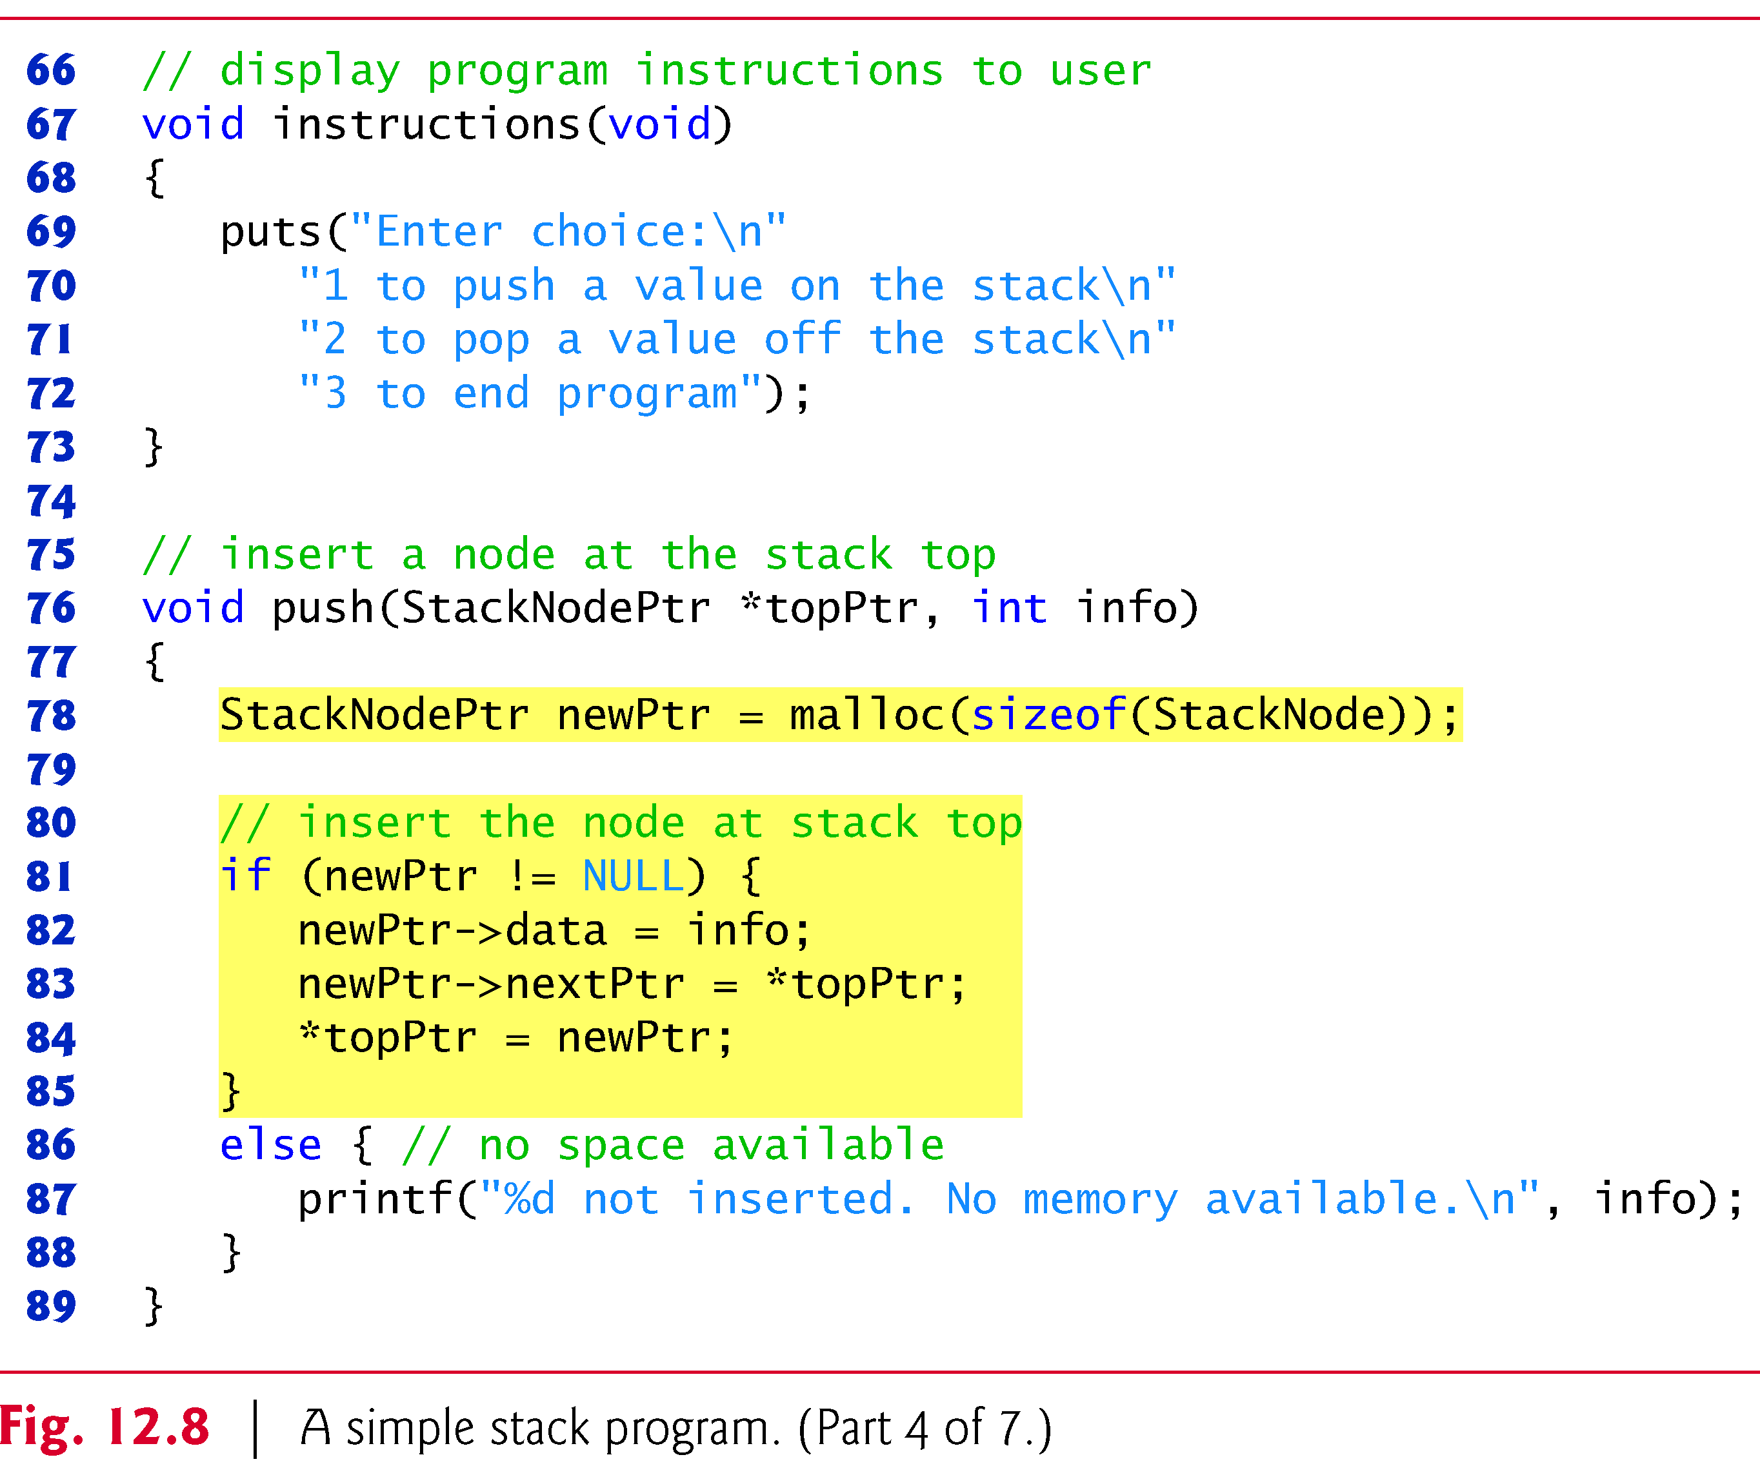
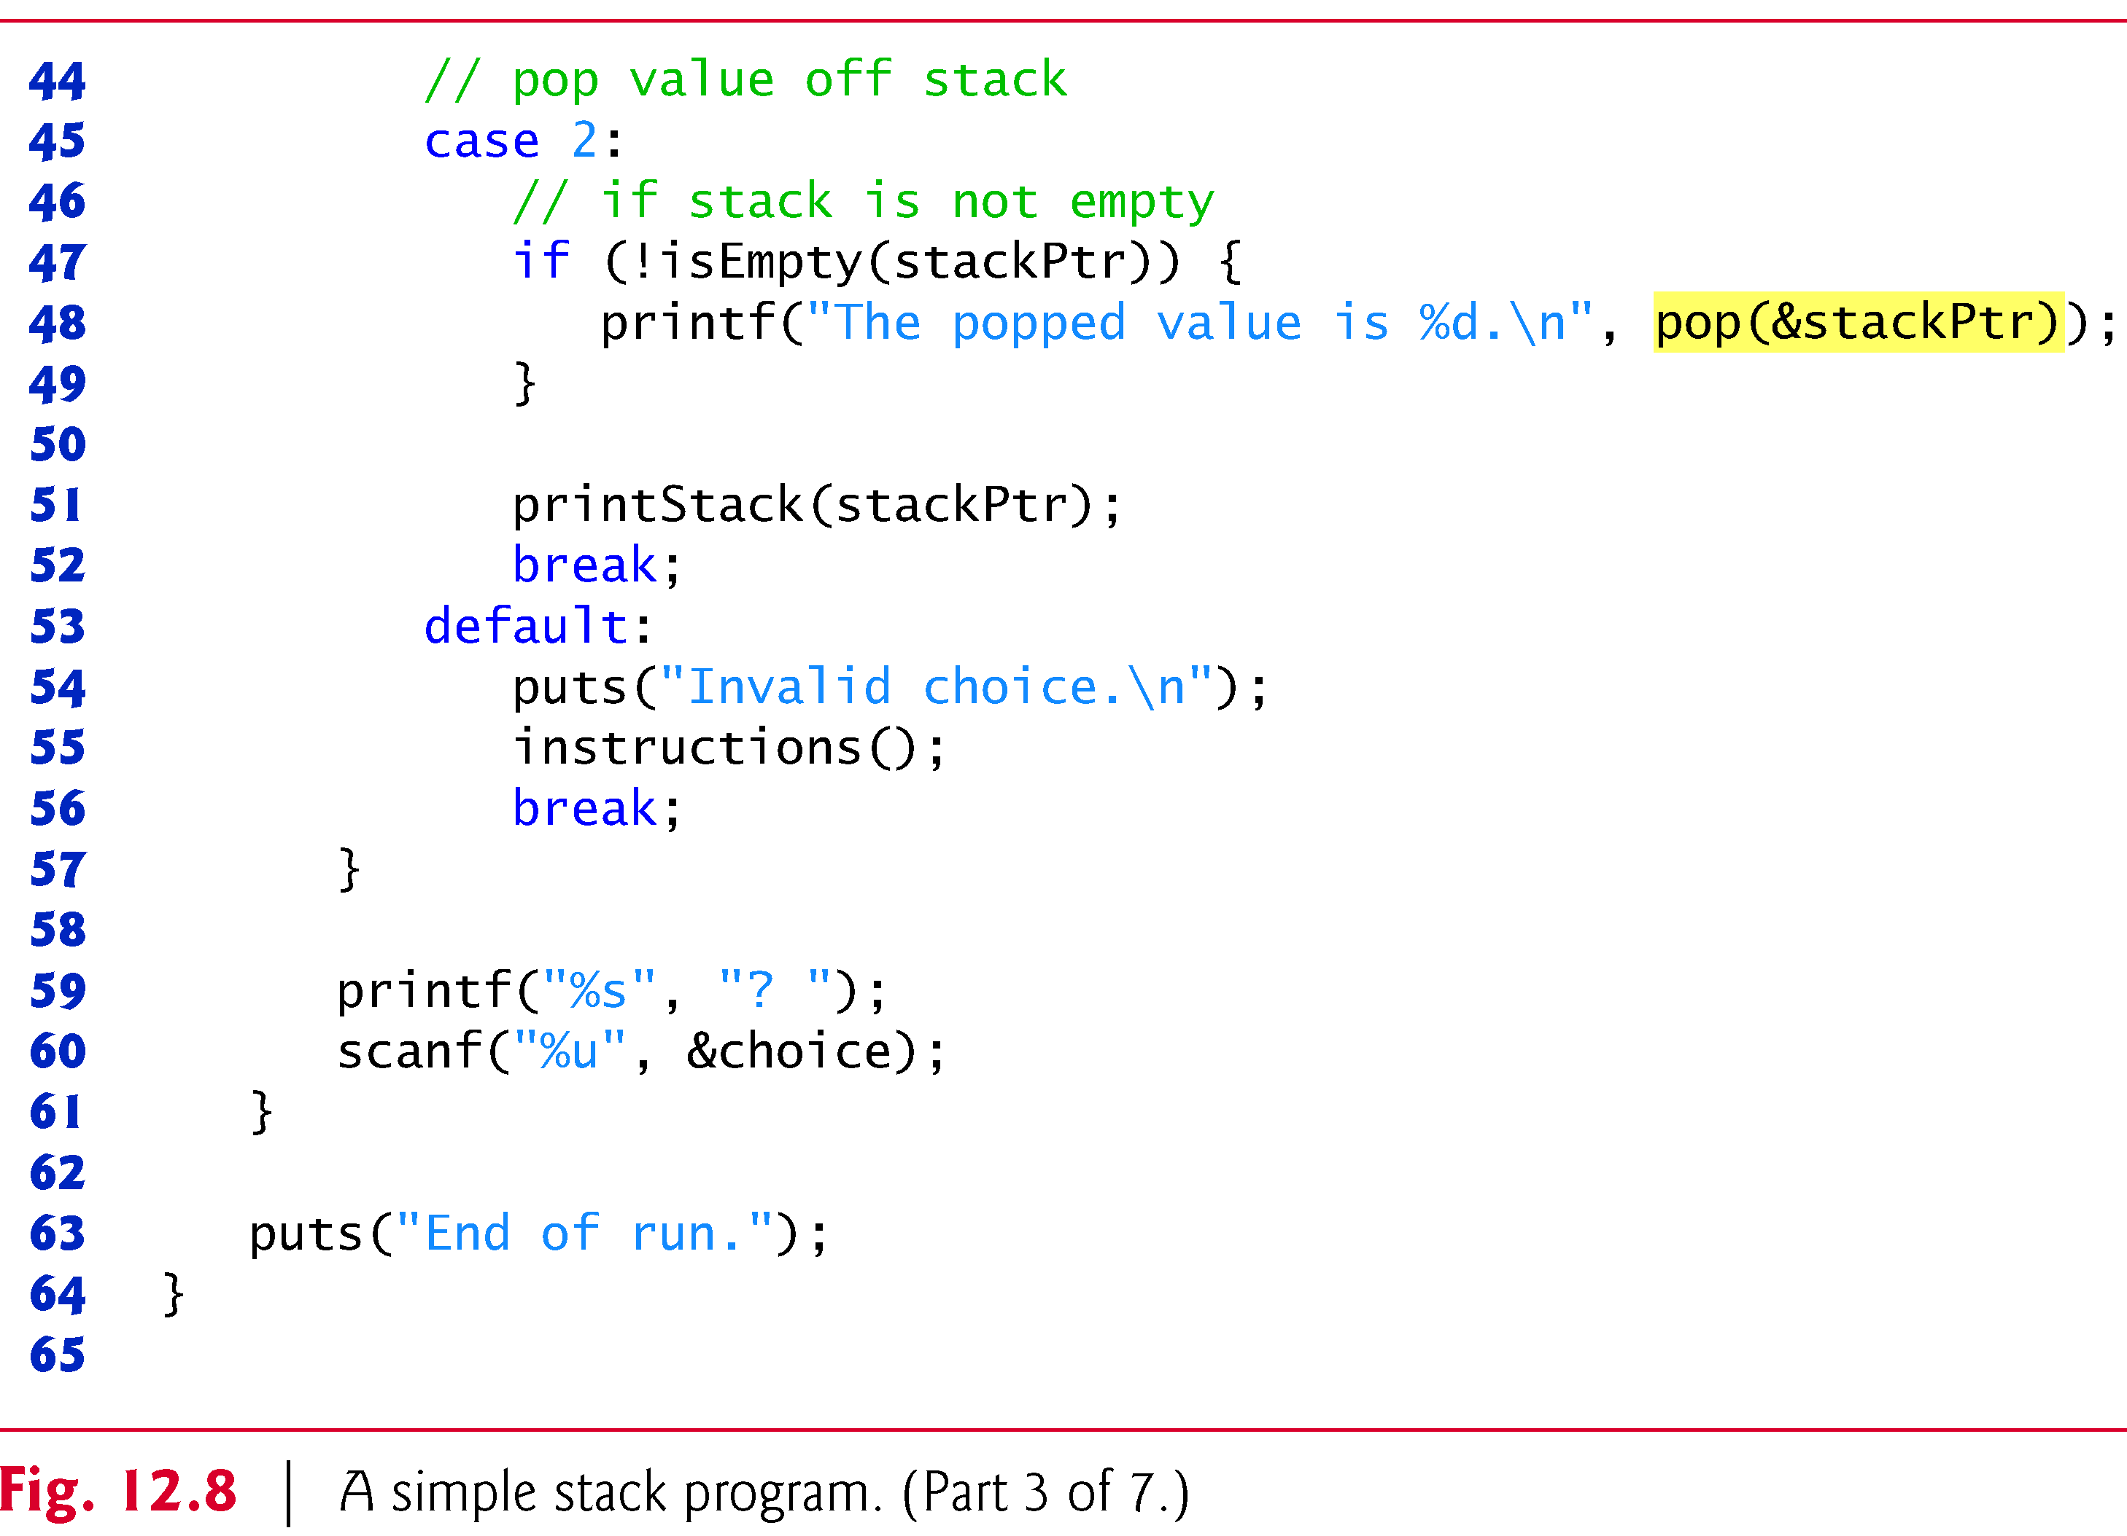

Slide 21
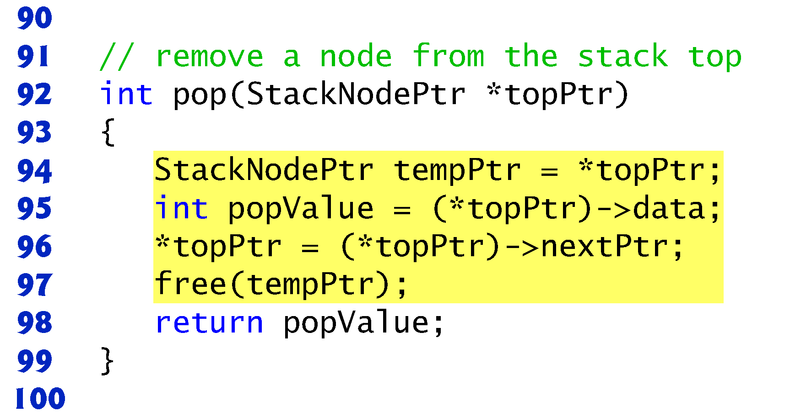
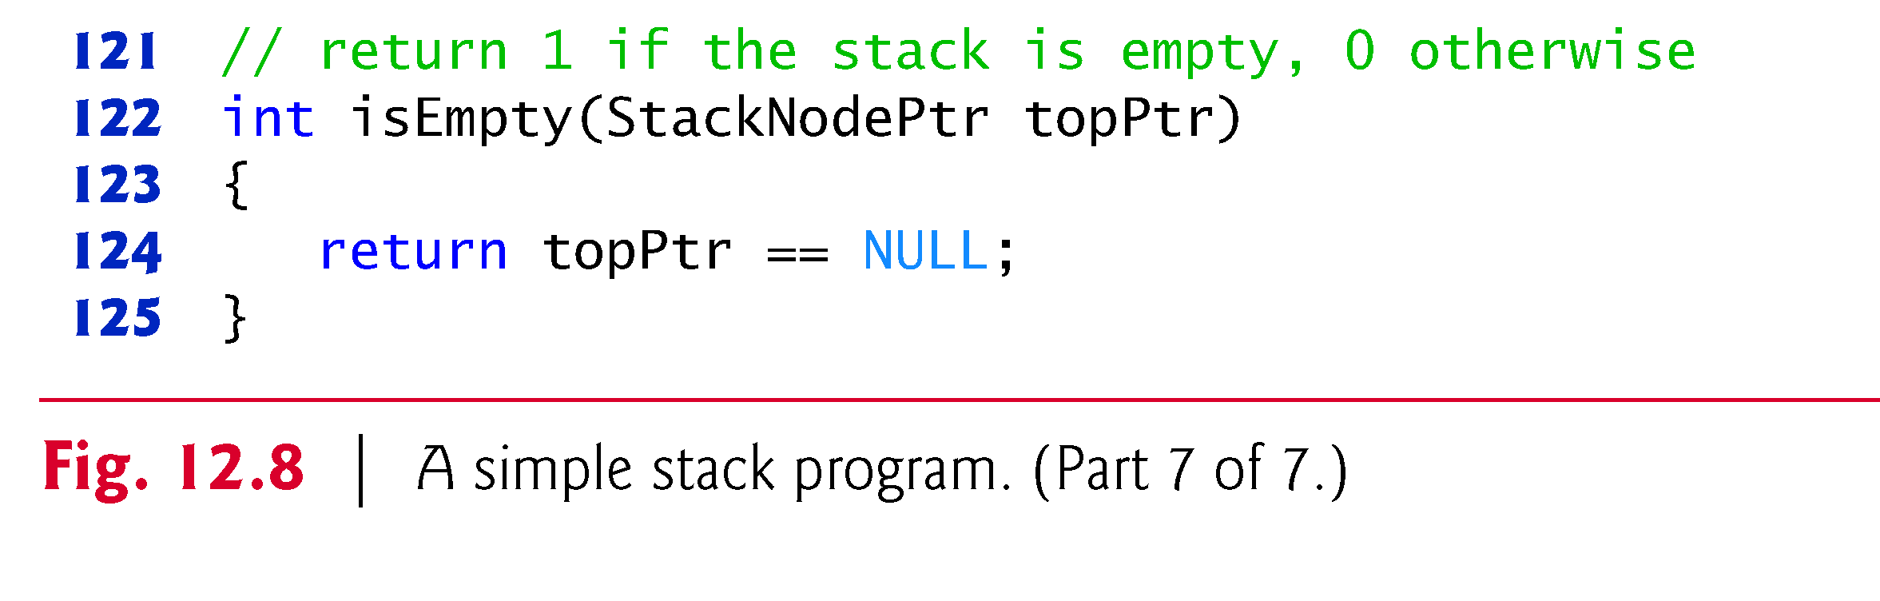
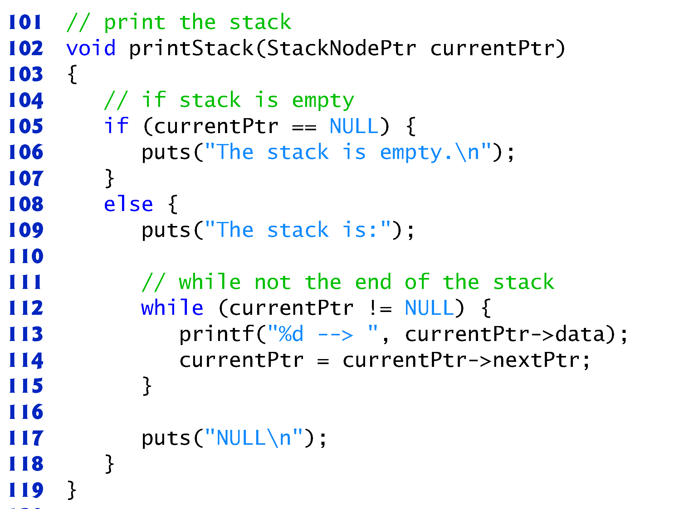

Slide 22
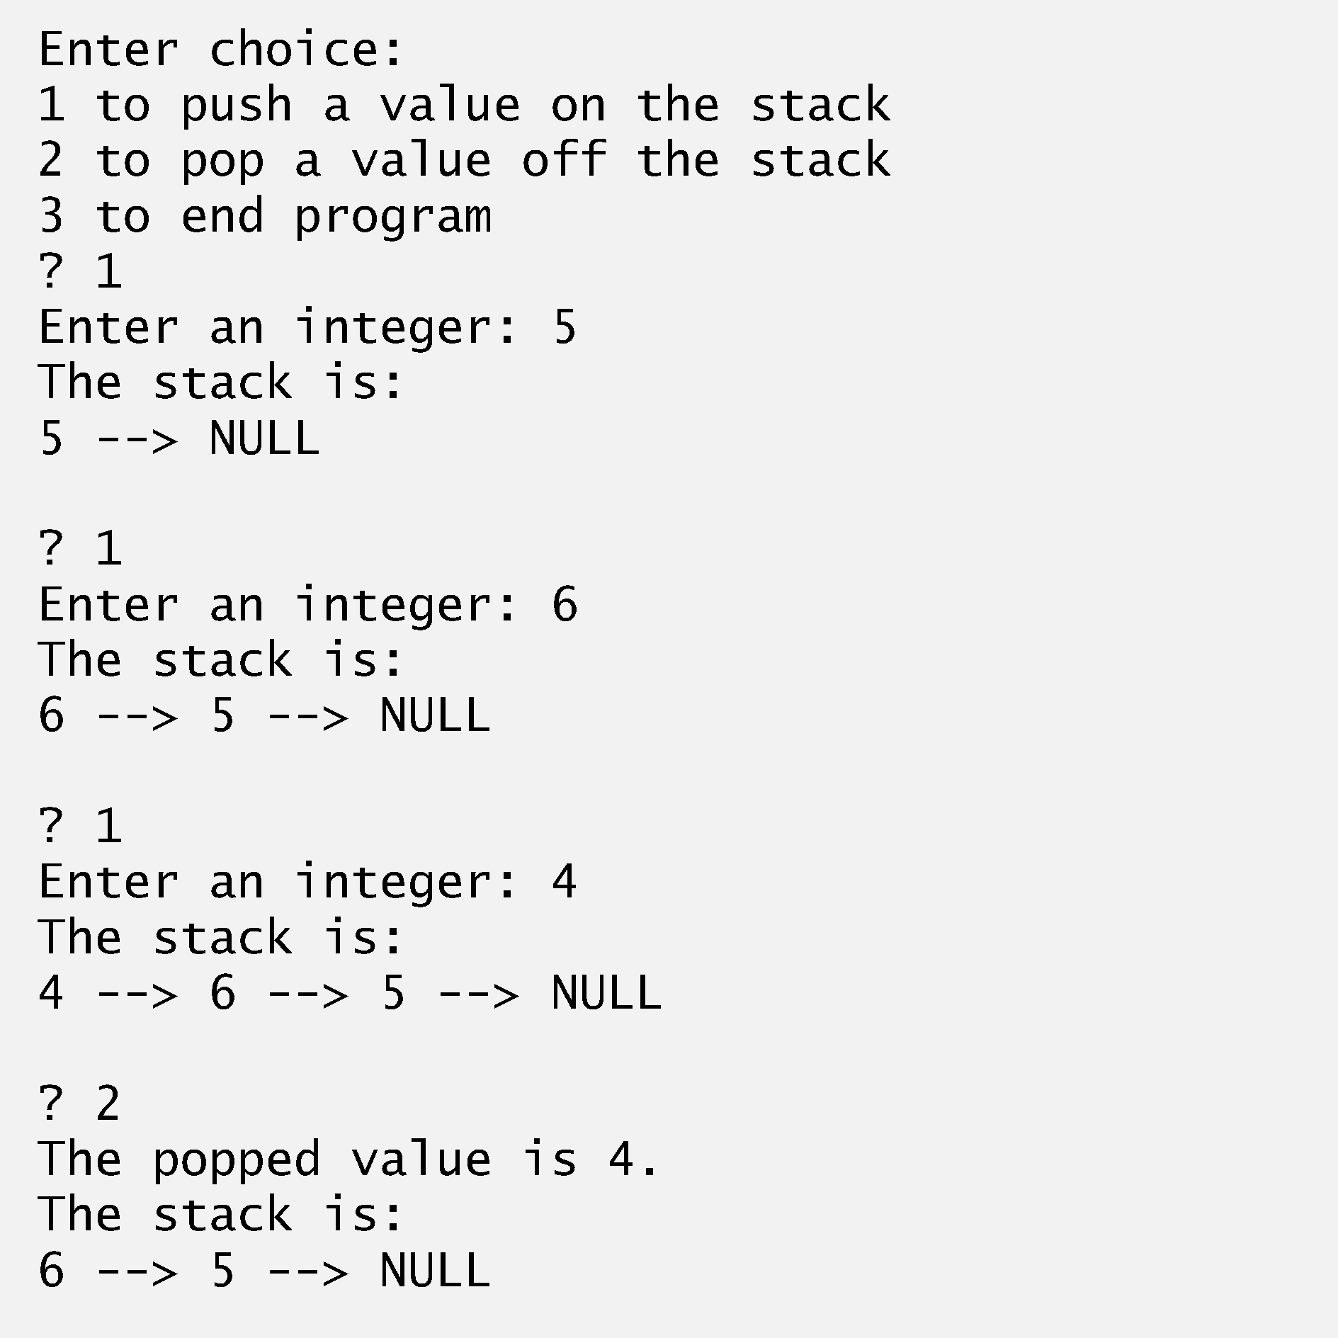
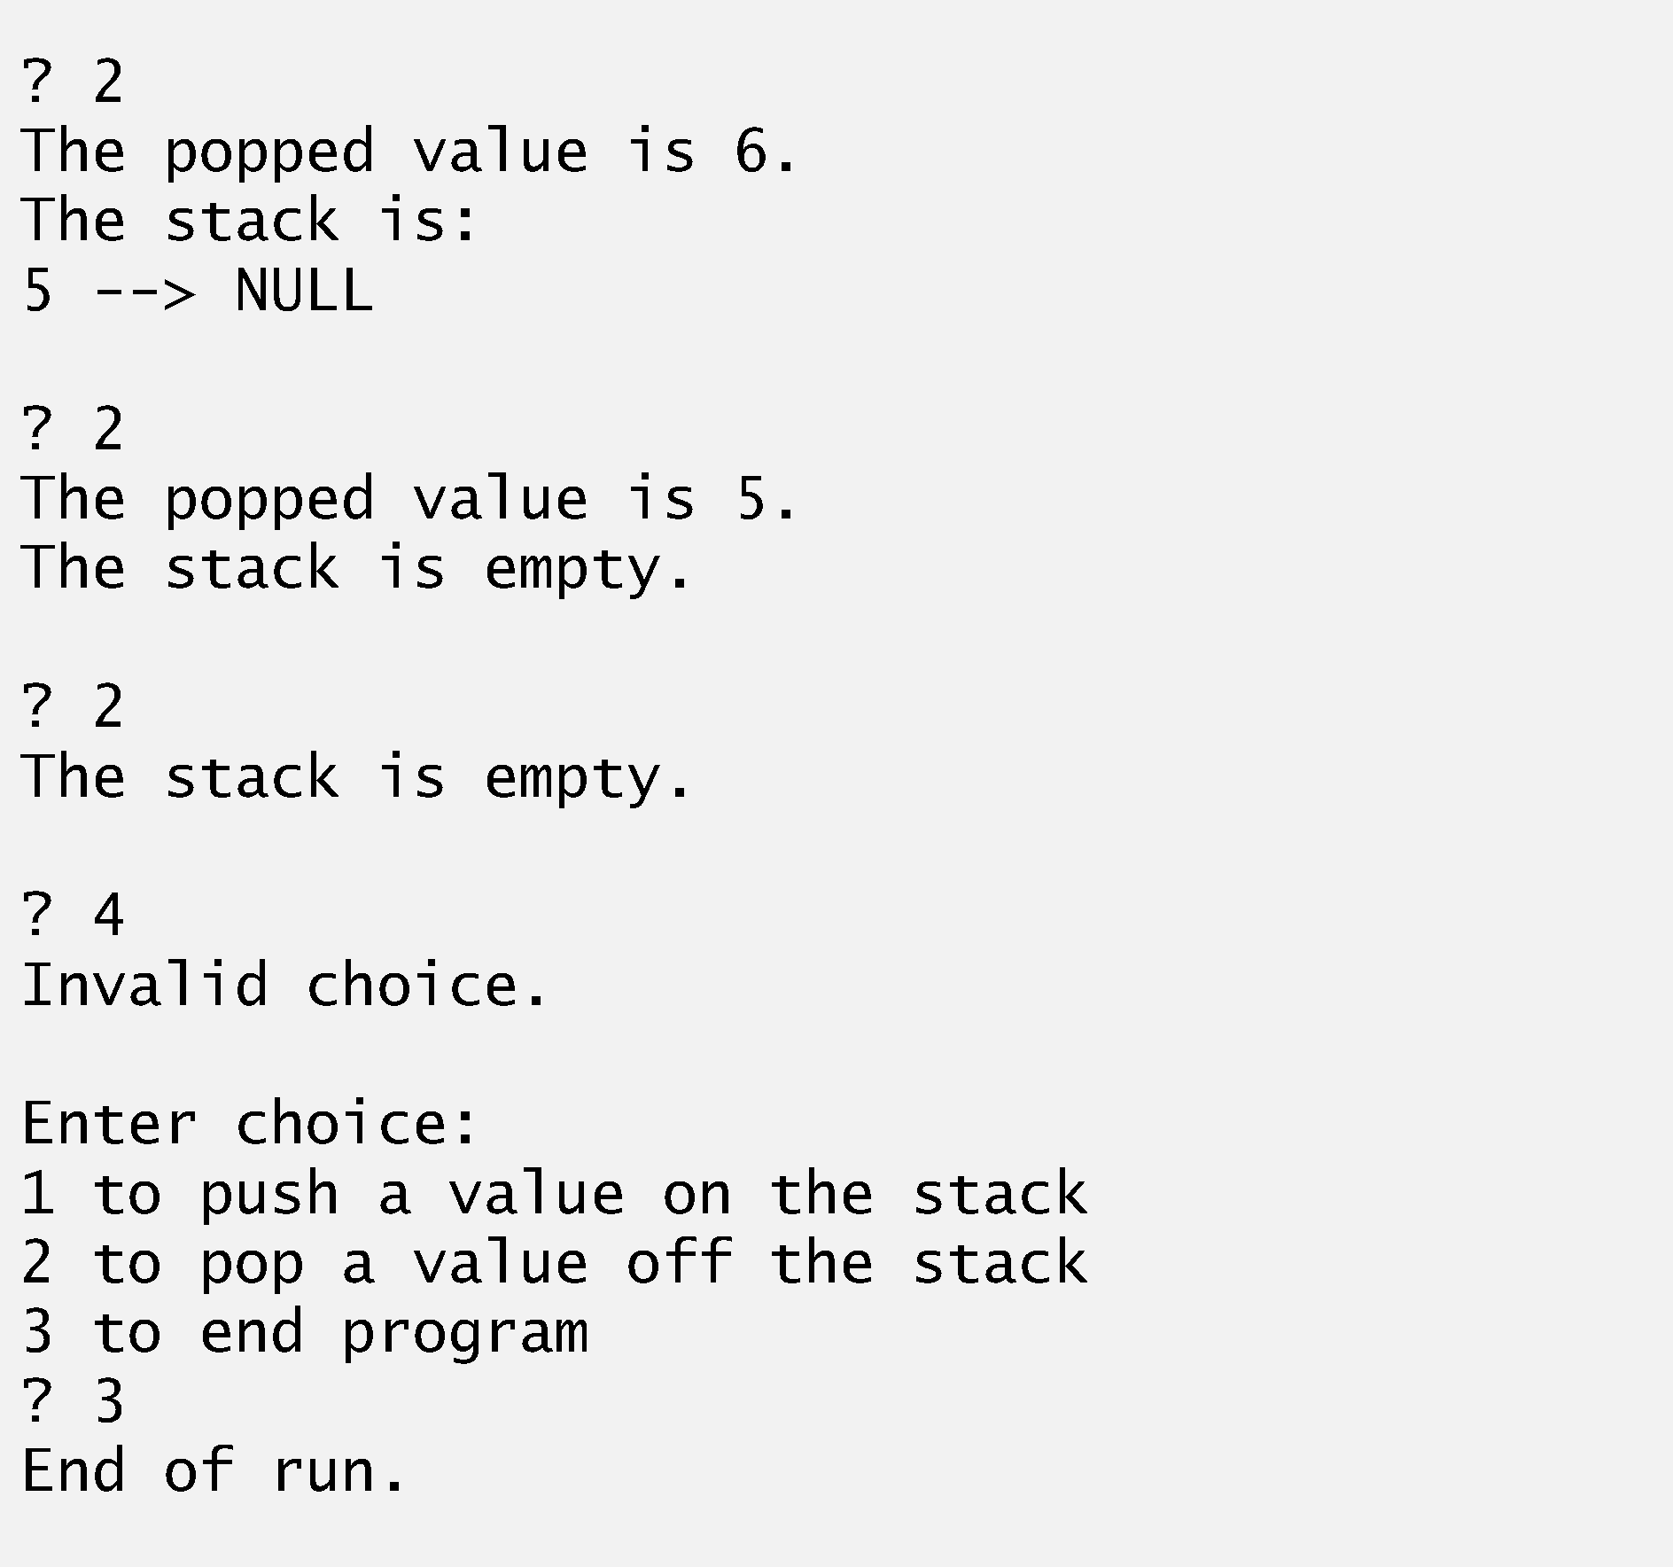

Slide 23
Stacks
Stack
New nodes can be added and removed only at the top
Similar to a pile of dishes
Last-in, first-out (LIFO)
Bottom of stack indicated by a link member to NULL
Constrained version of a linked list
push
Adds a new node to the top of the stack
pop
Removes a node from the top
Stores the popped value
Returns true if pop was successful

Slide 24
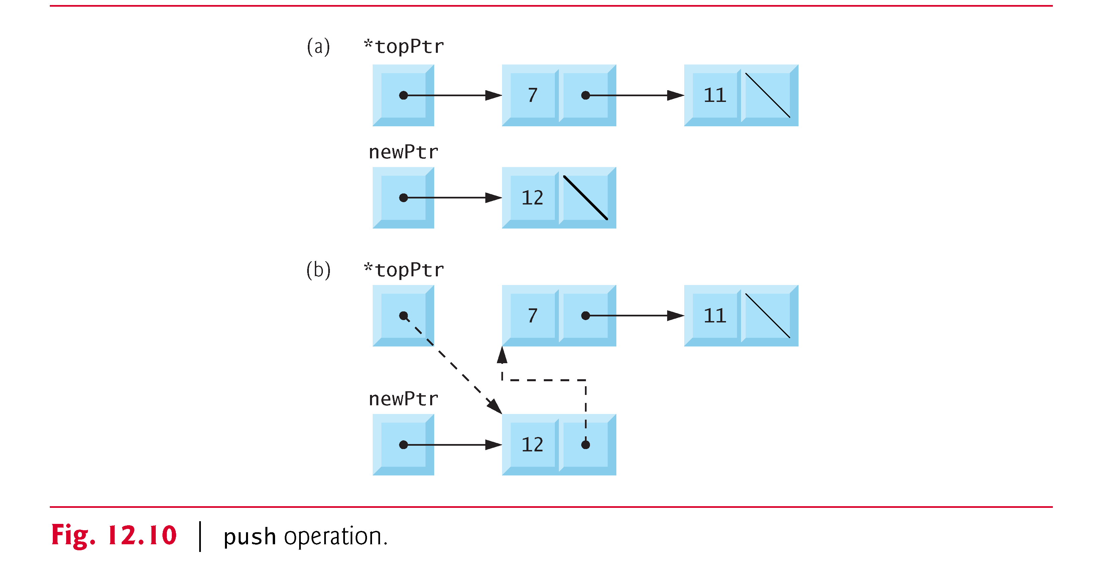
Stacks

Slide 25
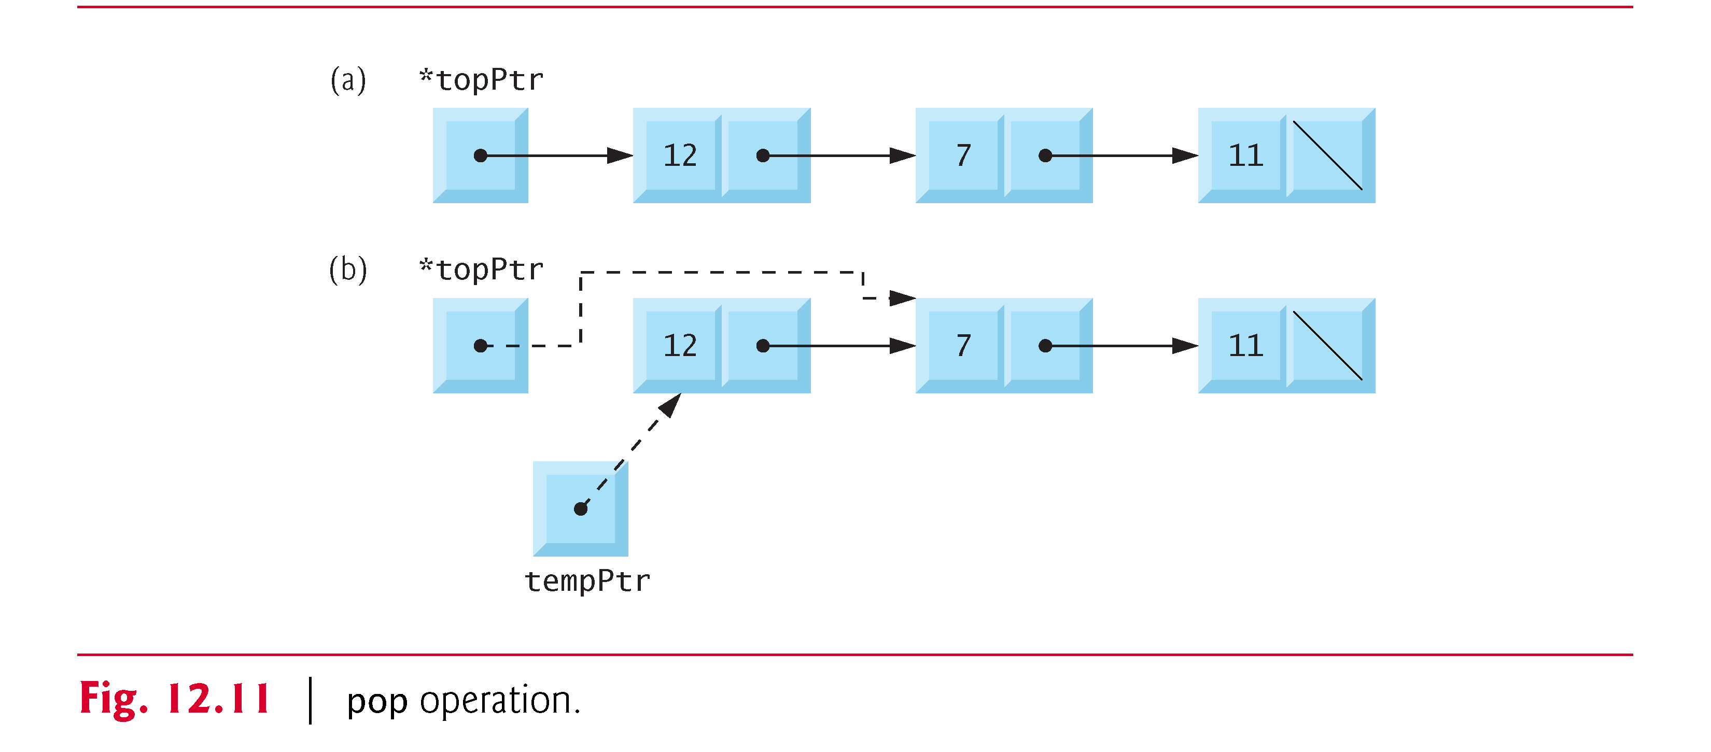
Stacks

Slide 26
Queues
Queue
Similar to a supermarket checkout line
First-in, first-out (FIFO)
Nodes are removed only from the head
Nodes are inserted only at the tail
Insert and remove operations
Enqueue (insert) and dequeue (remove)

Slide 27
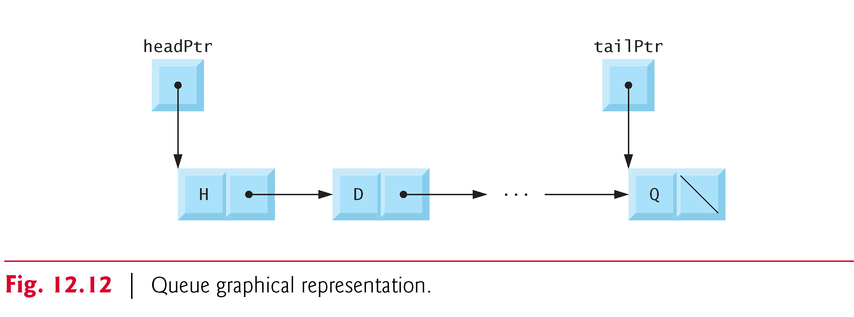
Queues

Slide 28
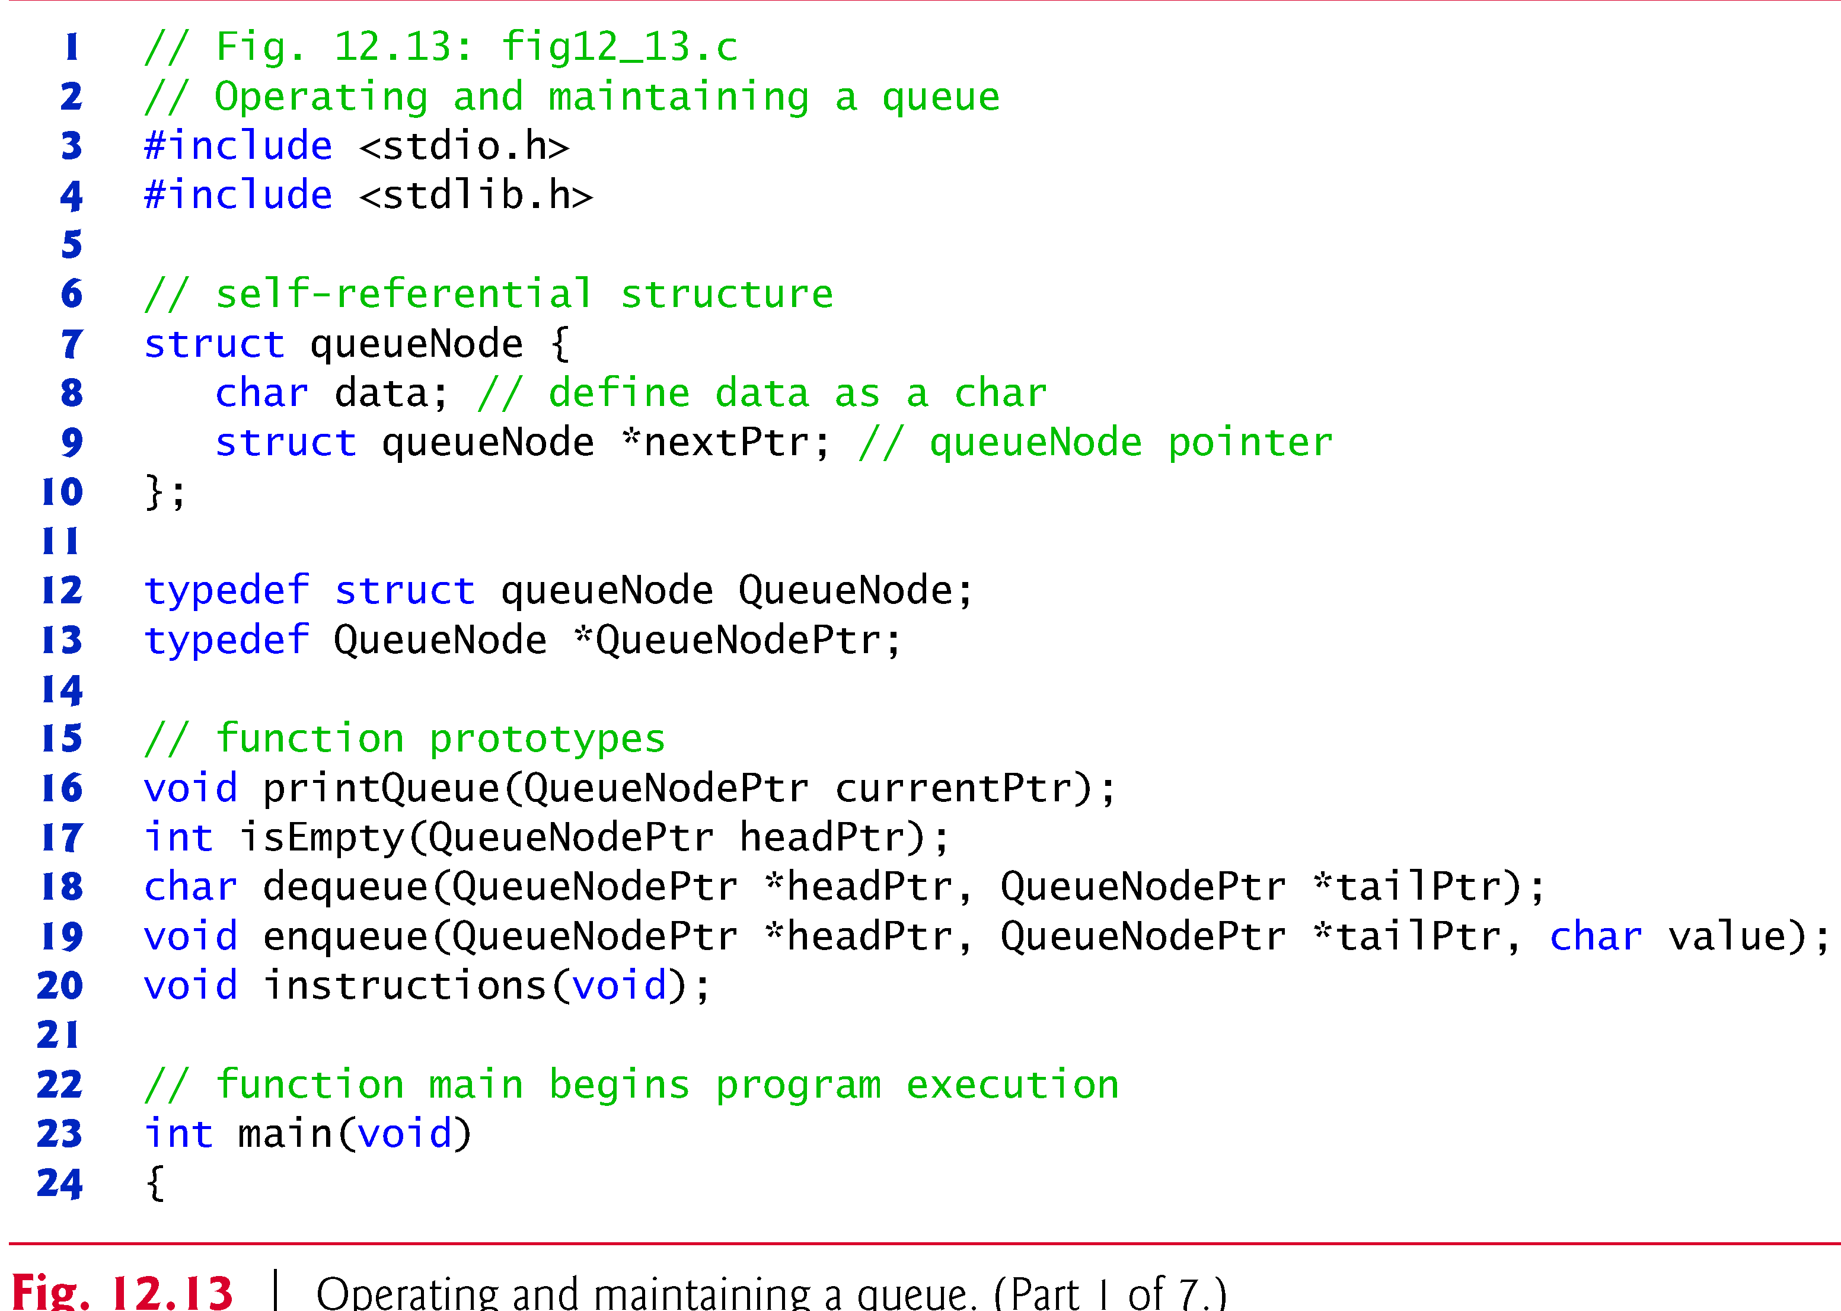
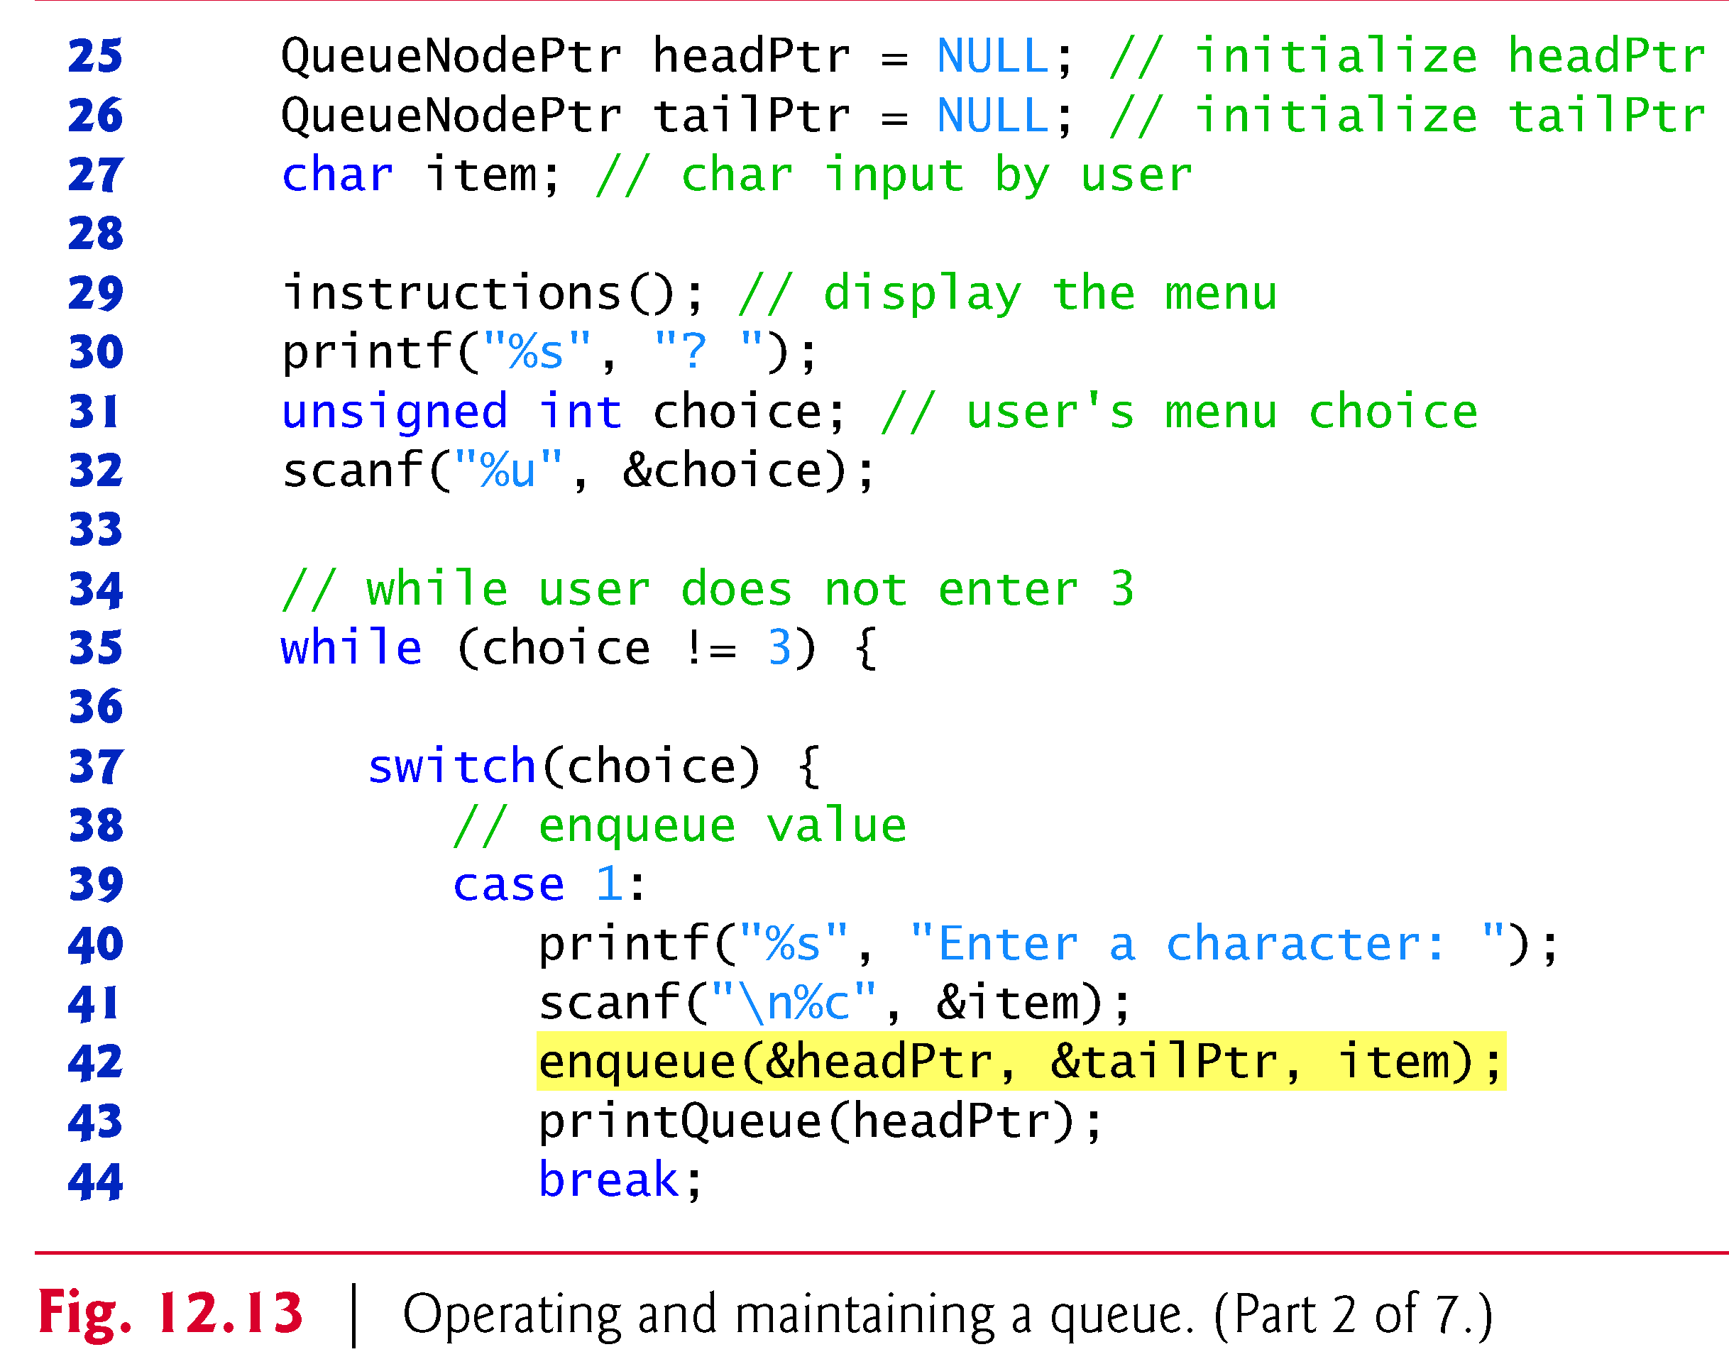

Slide 29
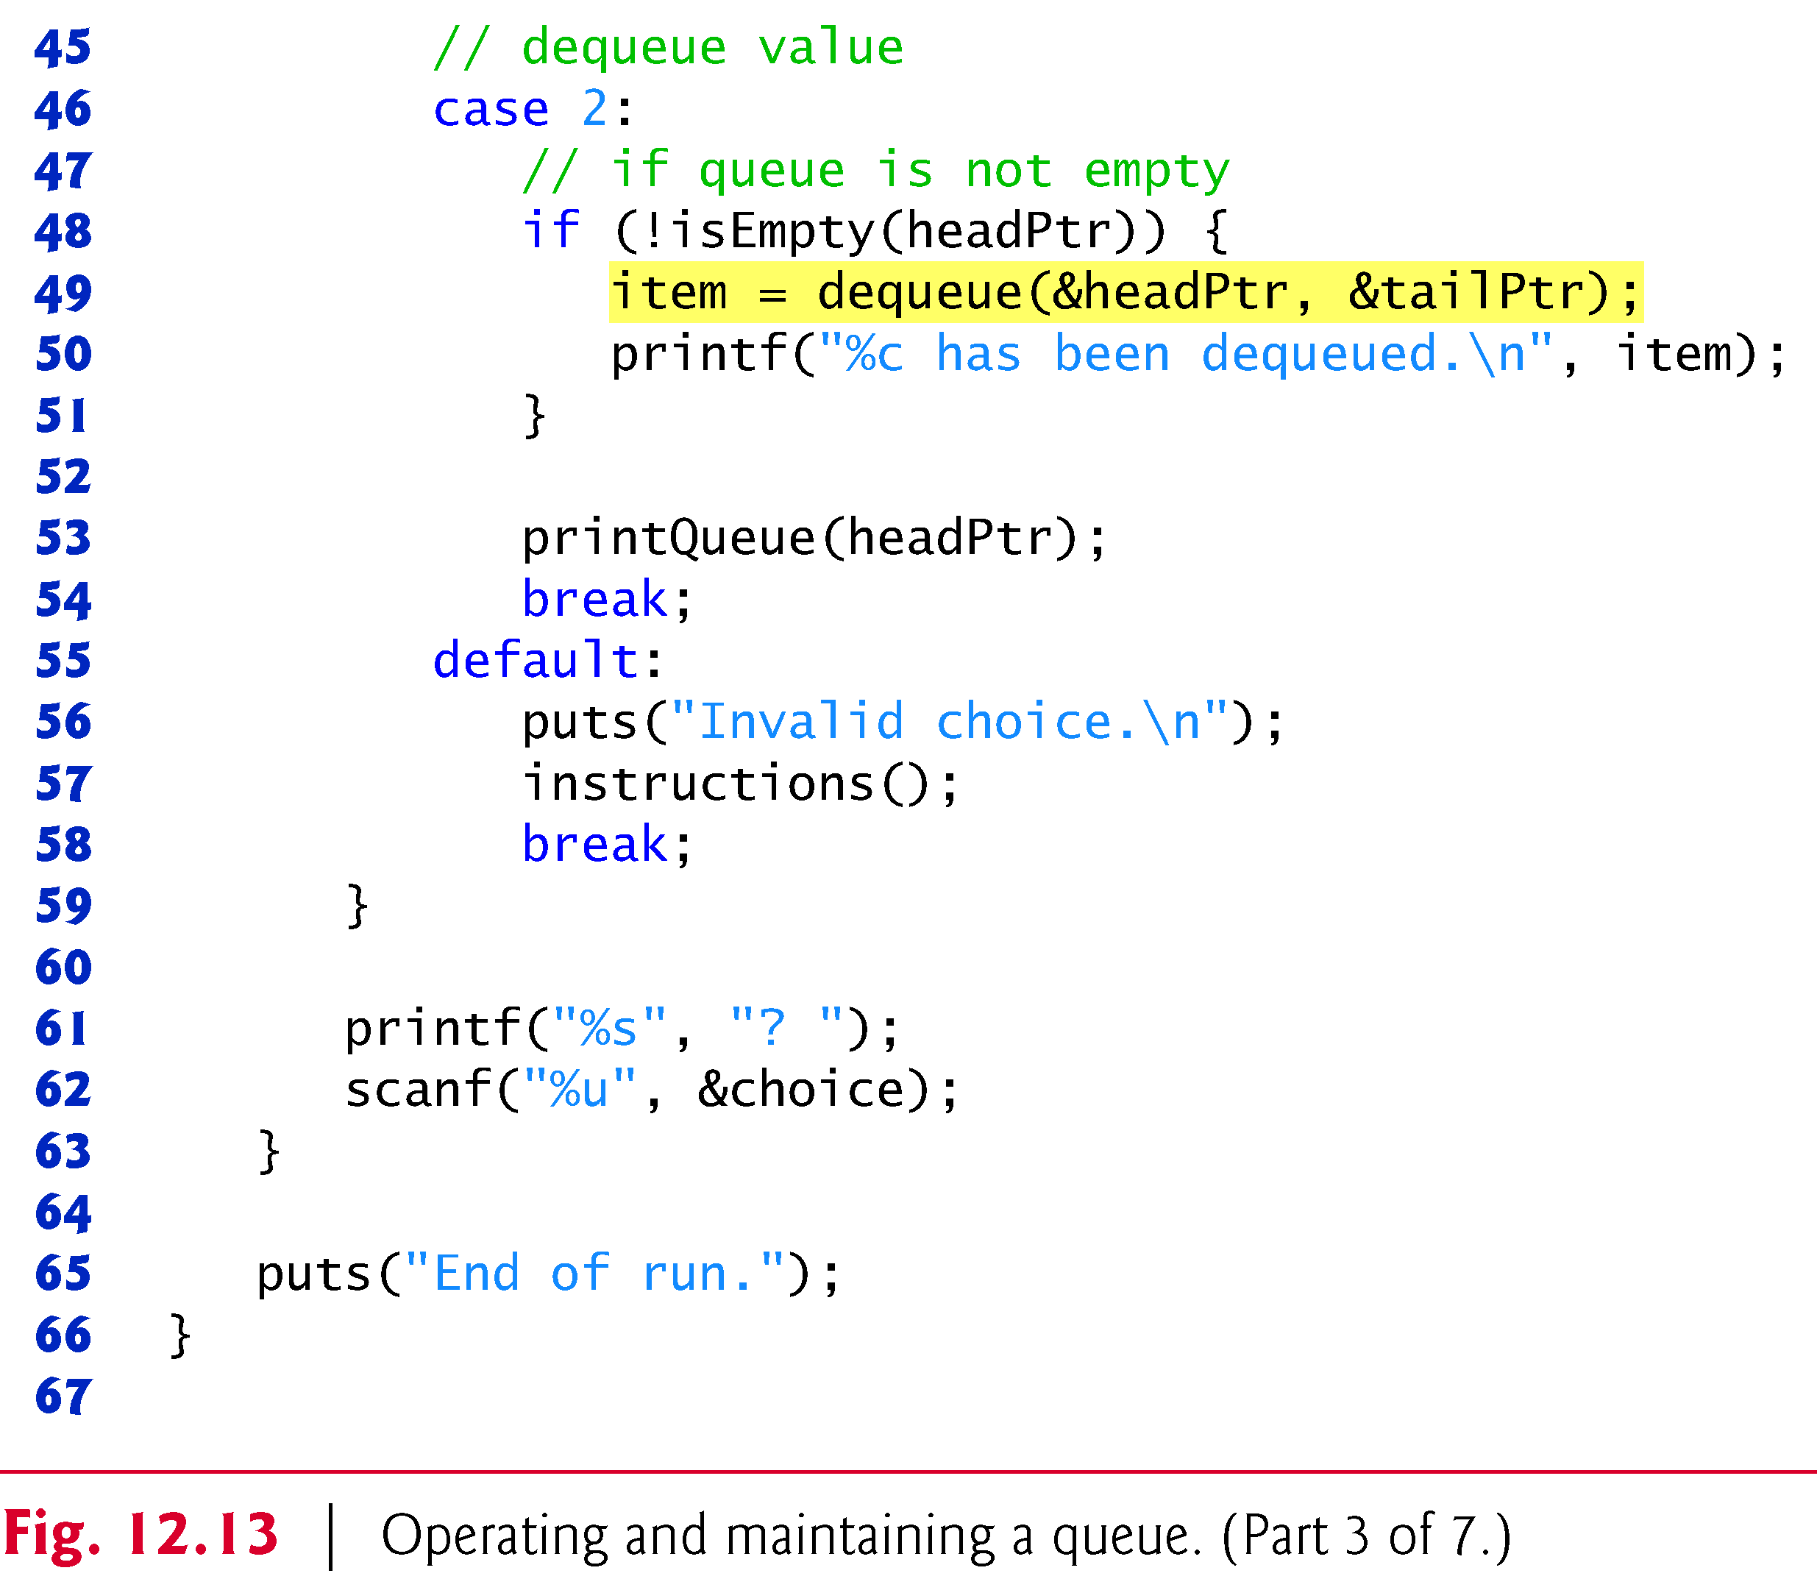
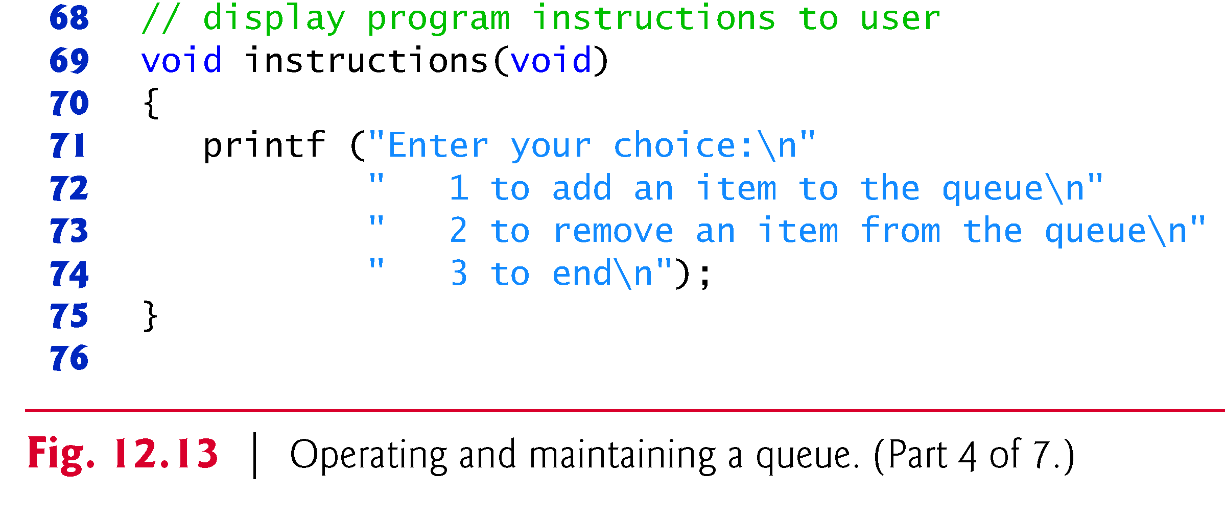

Slide 30
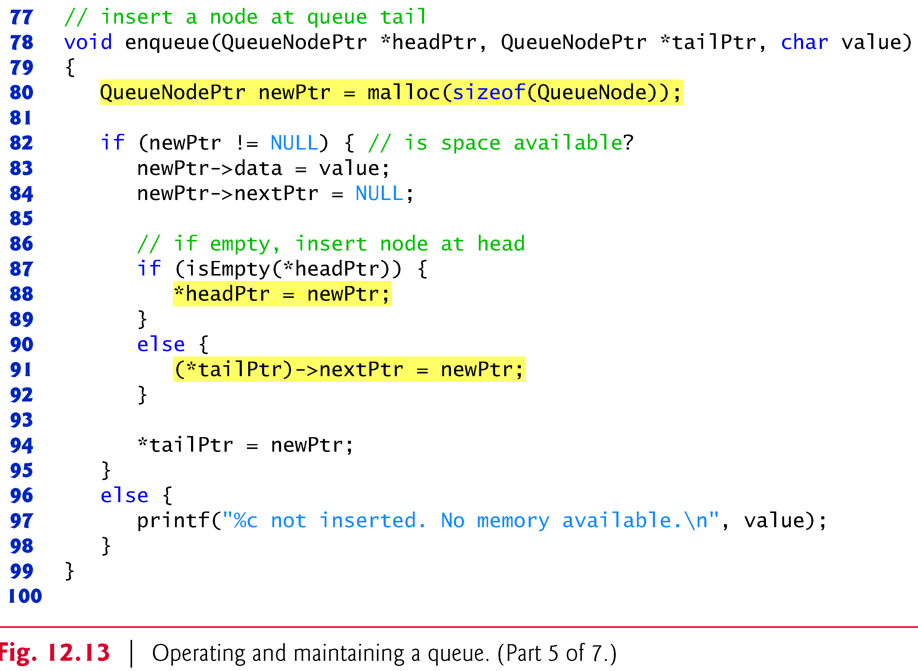
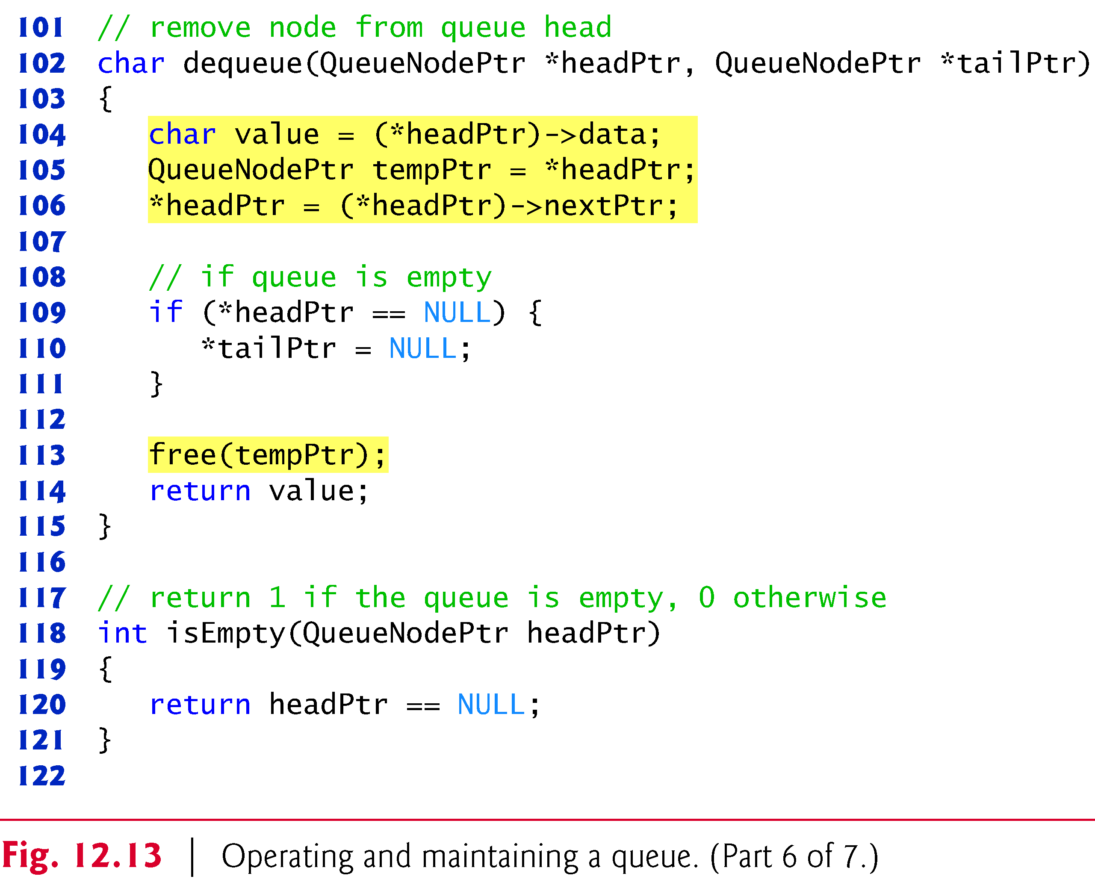

Slide 31
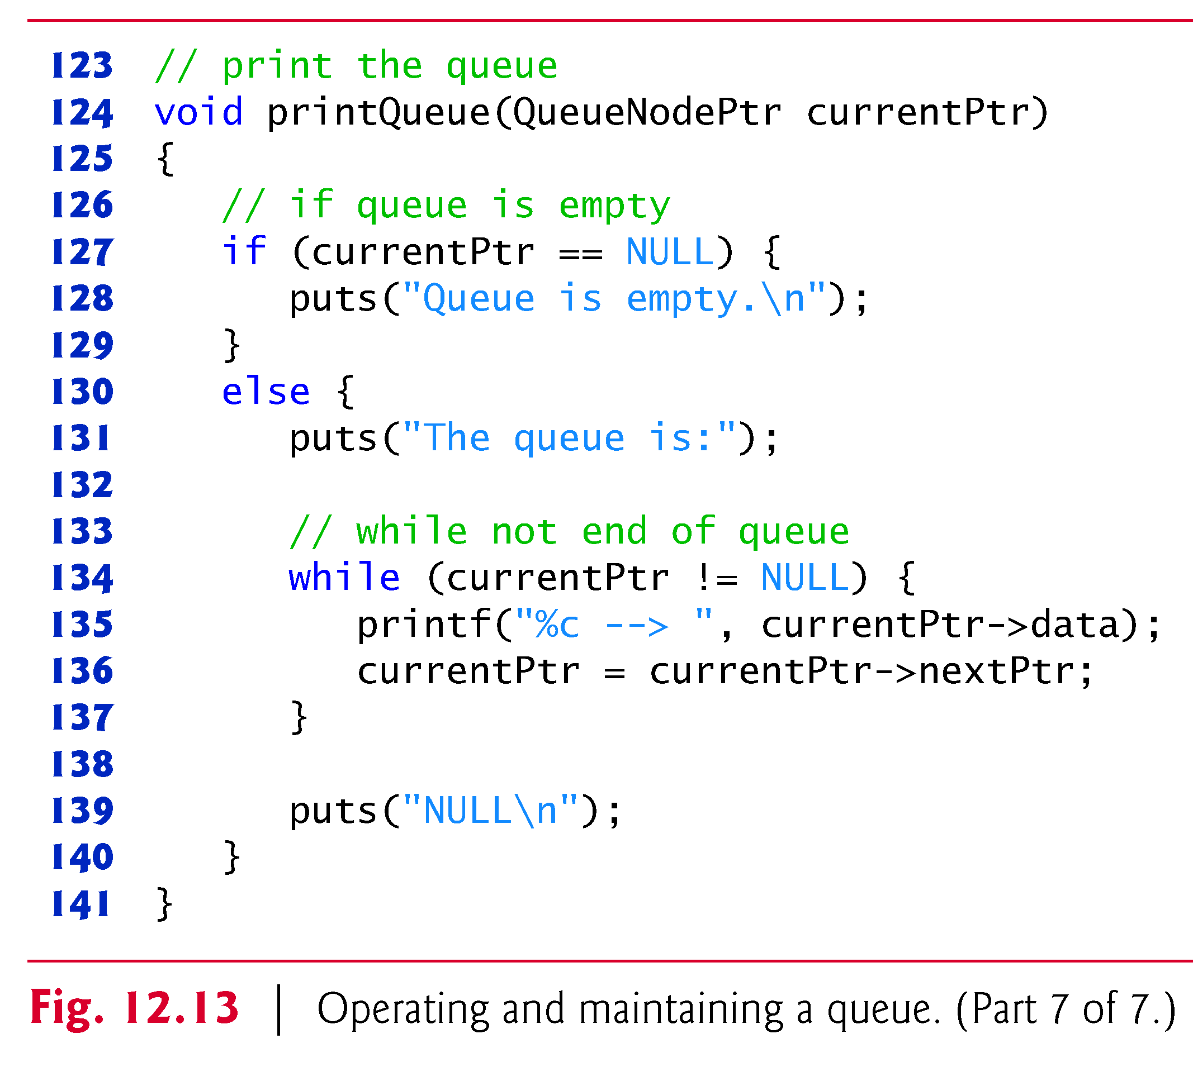

Slide 32
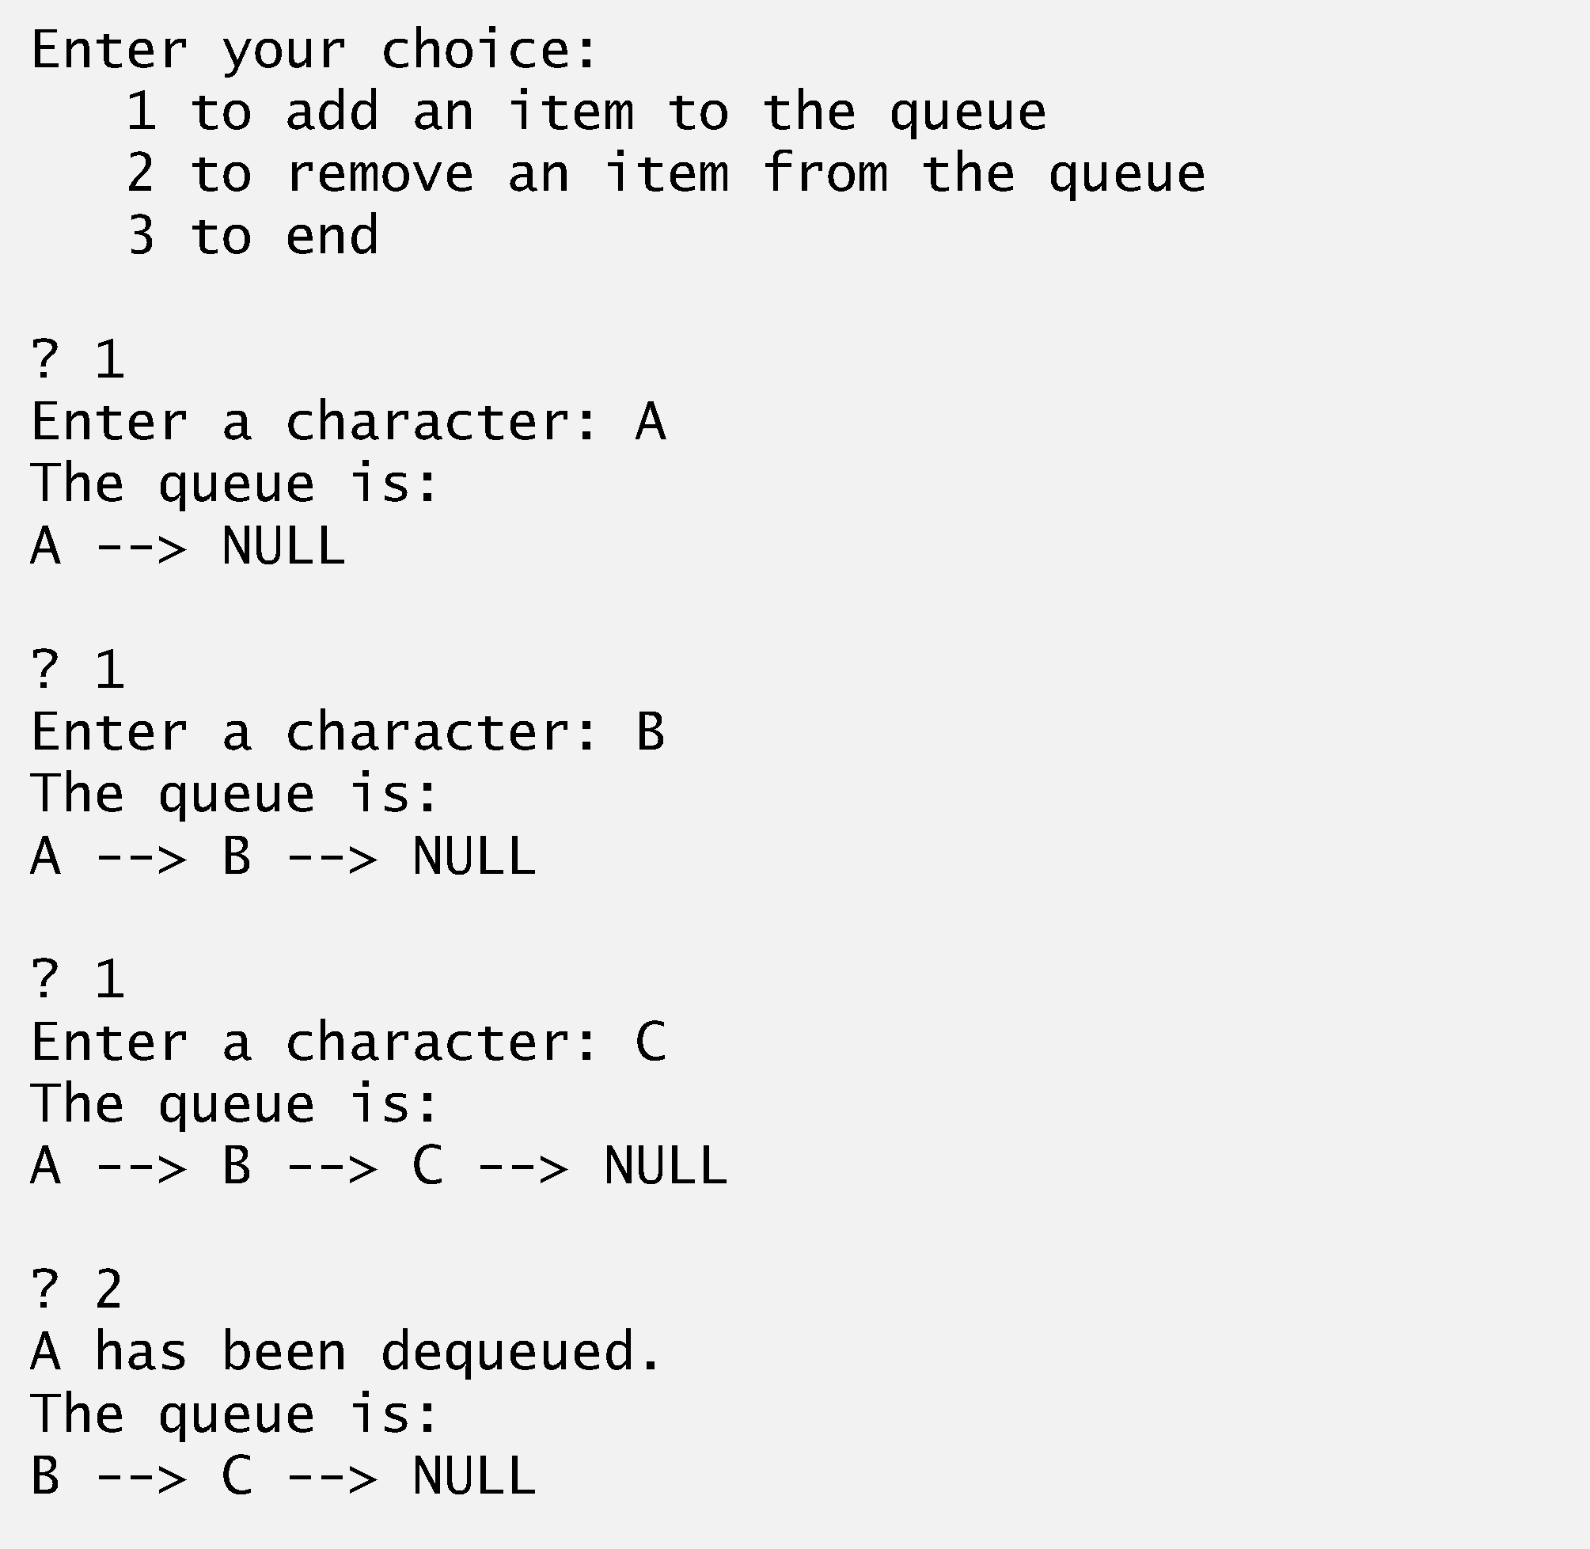
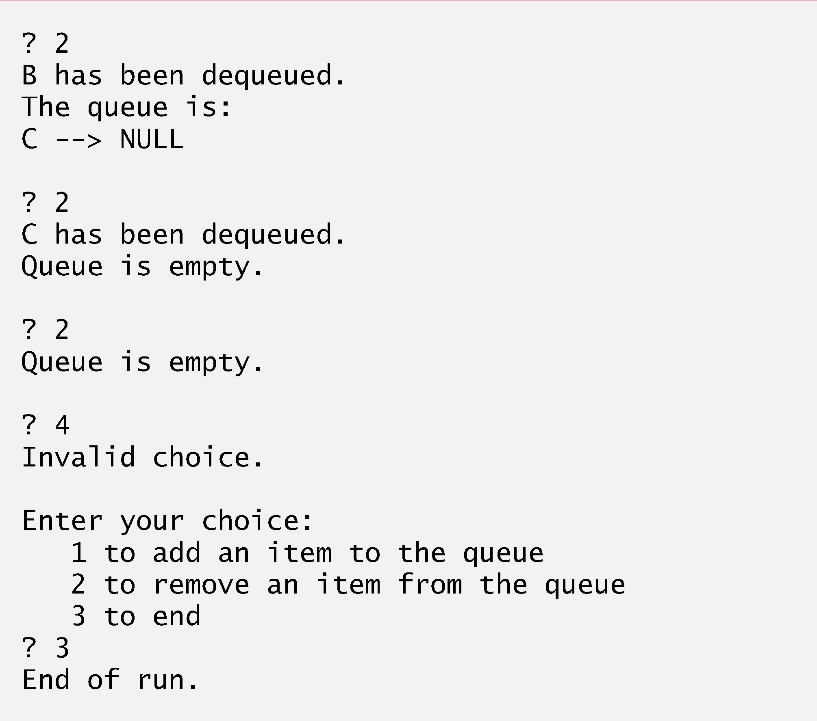

Slide 33
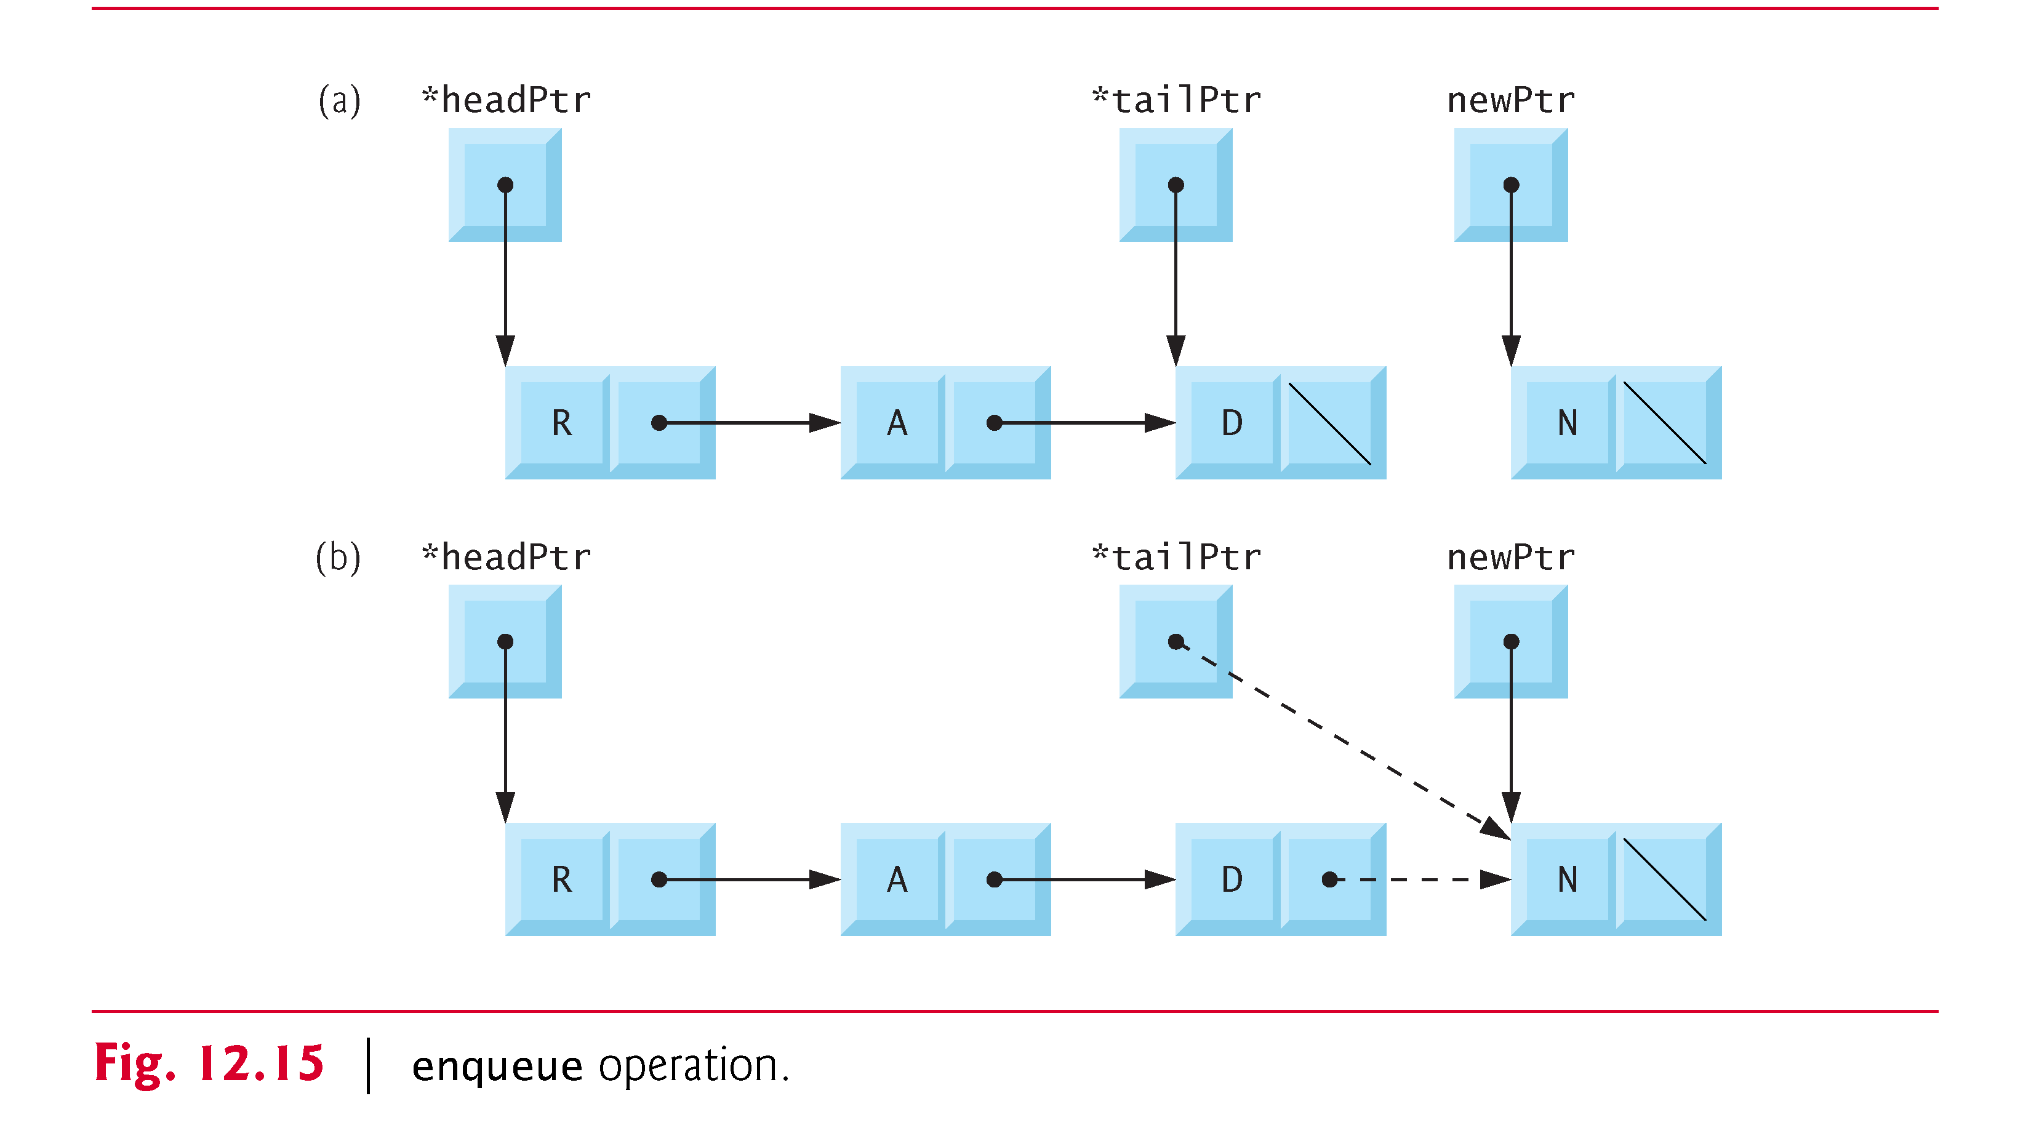
Queues

Slide 34
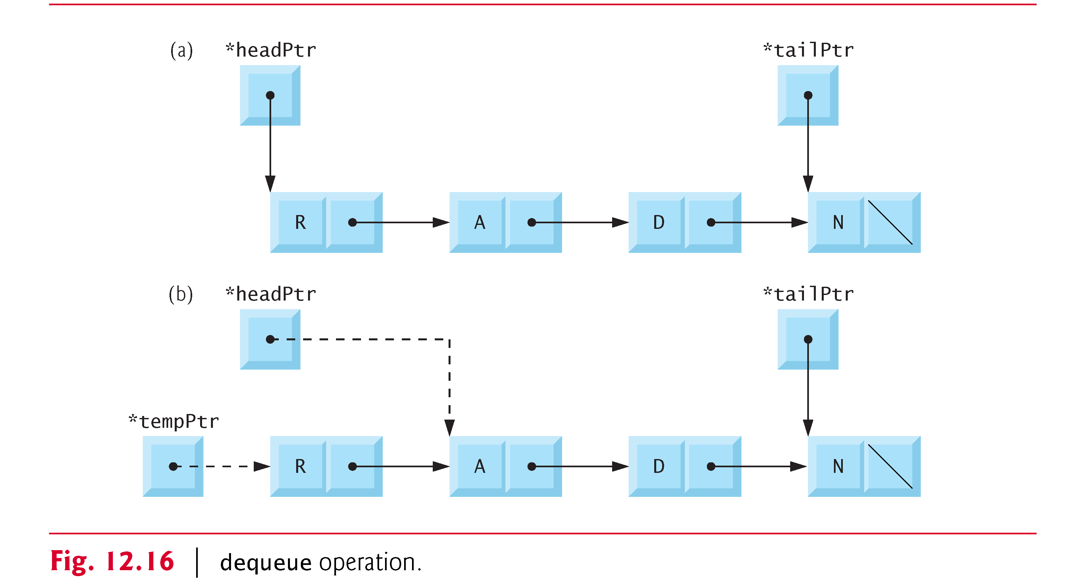
Queues

Slide 35
Trees
Tree nodes contain two or more links
All other data structures we have discussed only contain one
Binary trees
All nodes contain two links
None, one, or both of which may be NULL
The root node is the first node in a tree.
Each link in the root node refers to a child
A node with no children is called a leaf node

Slide 36
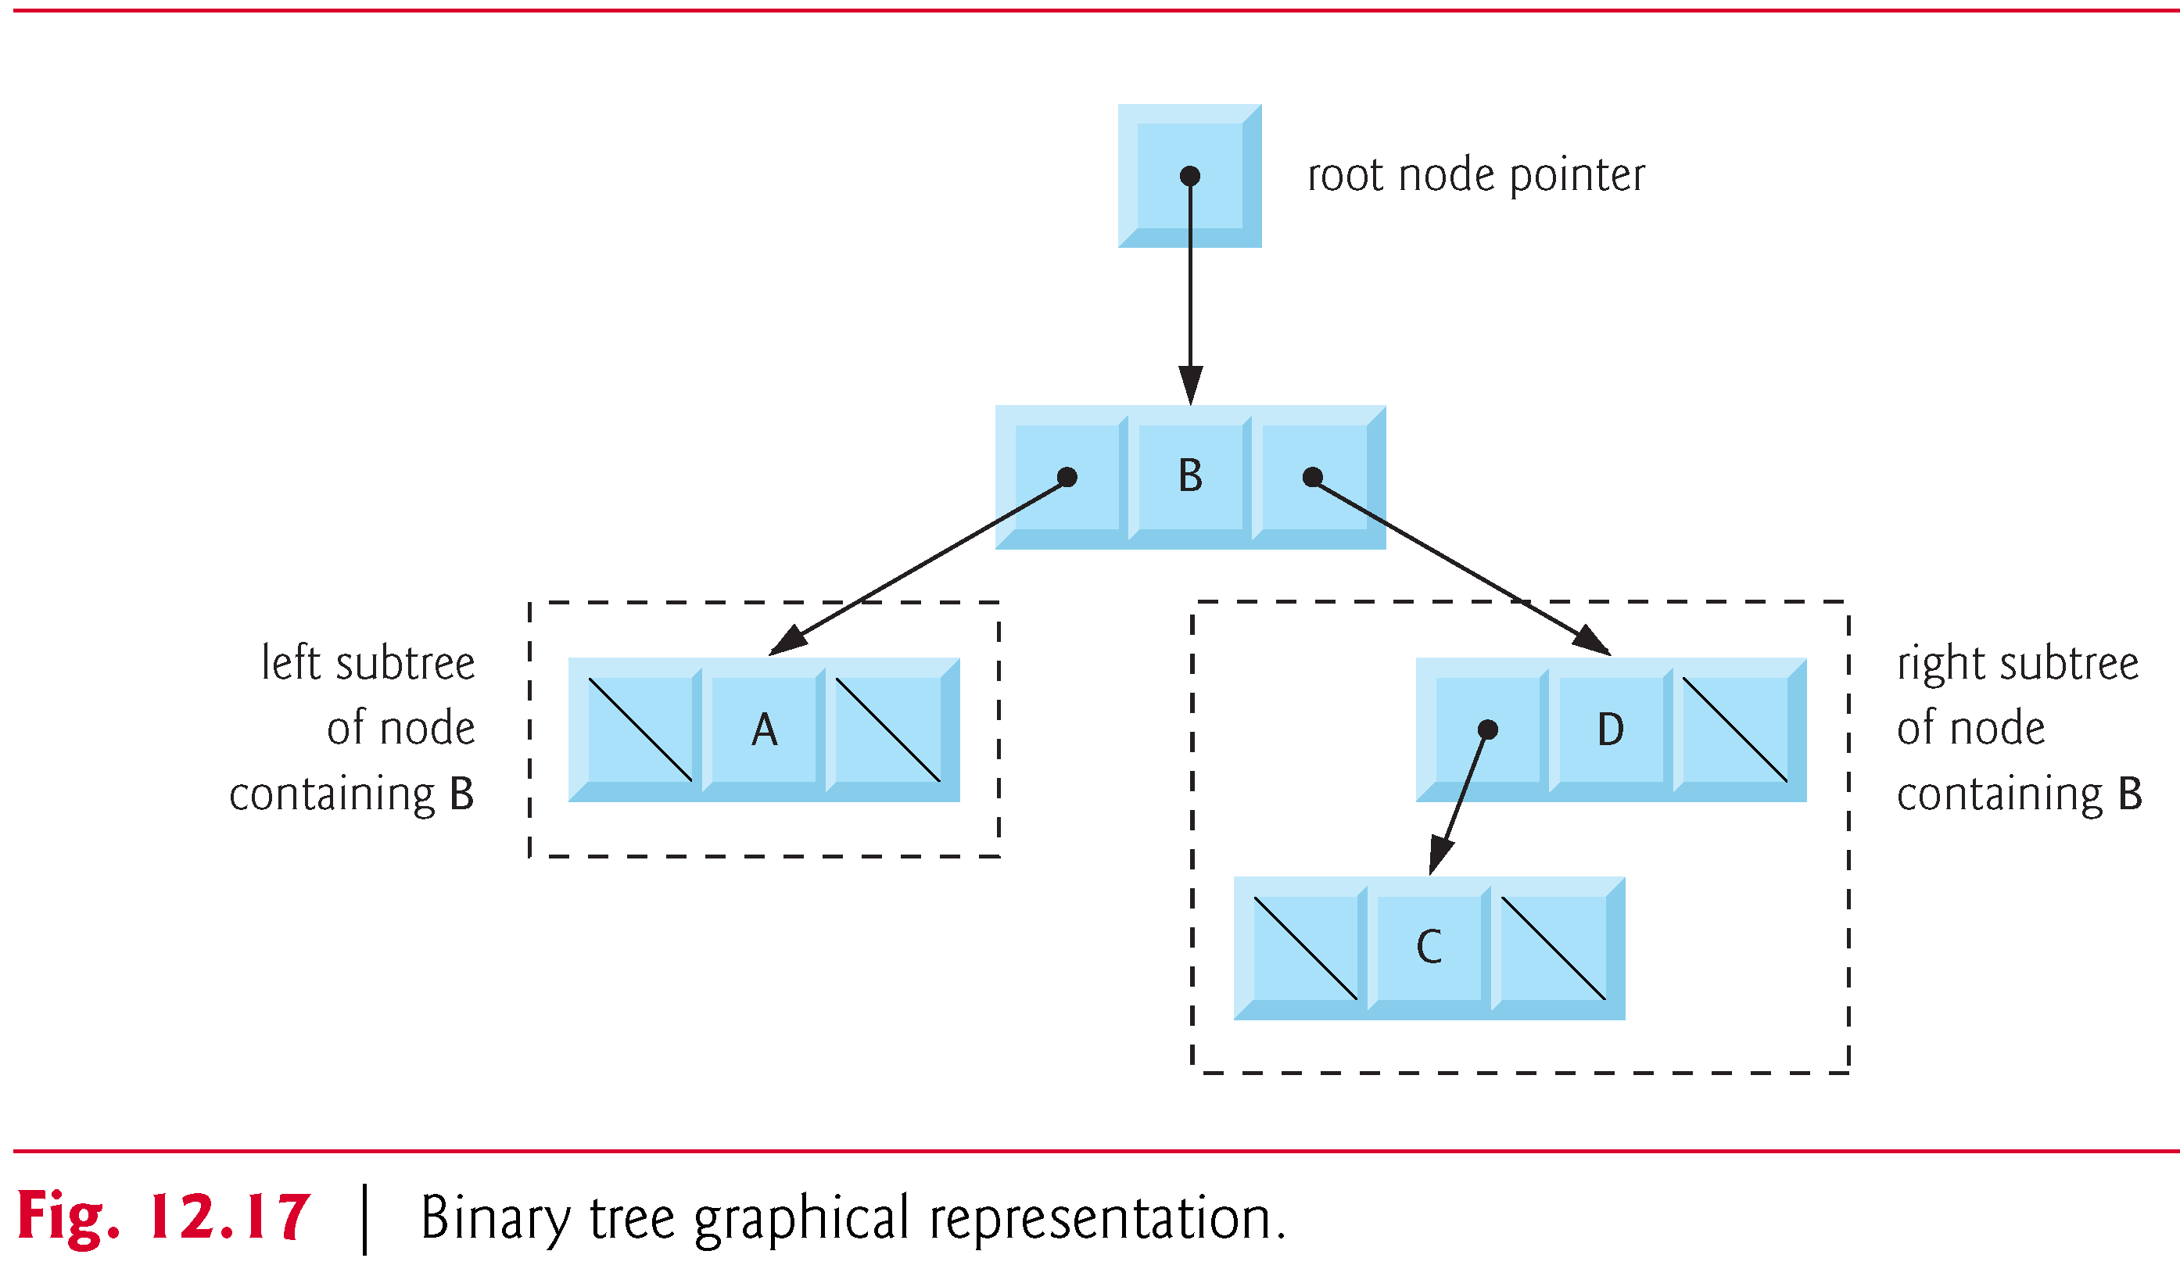
Trees

Slide 37
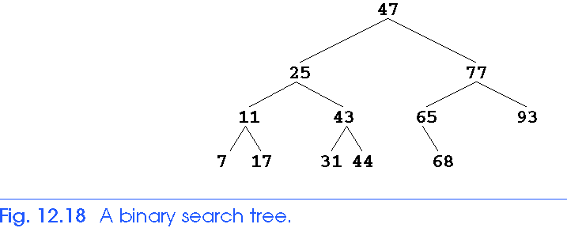
Trees
Binary search tree
Values in left subtree less than parent
Values in right subtree greater than parent
Facilitates duplicate elimination
Fast searches - for a balanced tree, maximum of log n comparisons
2

Slide 38
Trees
Tree traversals:
Inorder traversal – prints the node values in ascending order
1. Traverse the left subtree with an inorder traversal
2. Process the value in the node (i.e., print the node value)
3. Traverse the right subtree with an inorder traversal
Preorder traversal
1. Process the value in the node
2. Traverse the left subtree with a preorder traversal
3. Traverse the right subtree with a preorder traversal
Postorder traversal
1. Traverse the left subtree with a postorder traversal
2. Traverse the right subtree with a postorder traversal
3. Process the value in the node

Slide 39
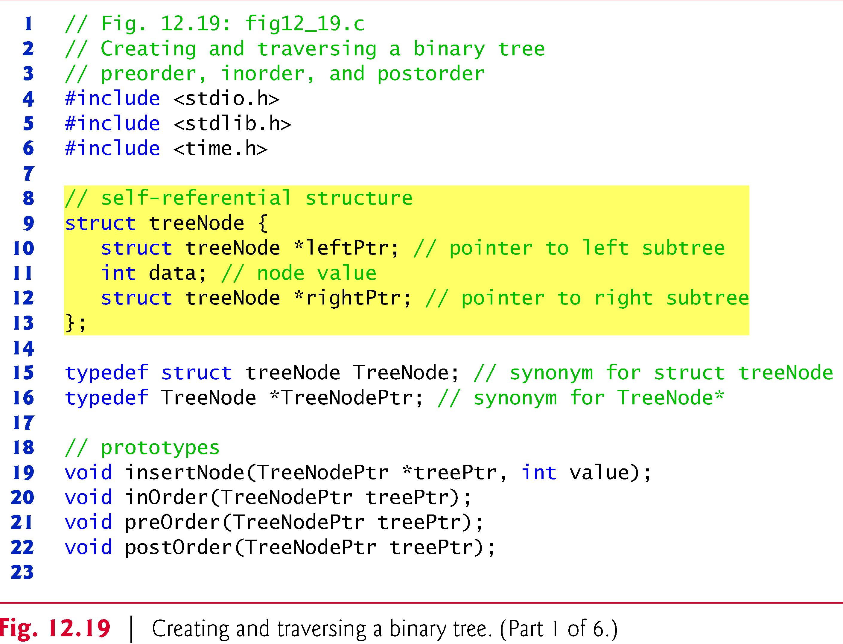
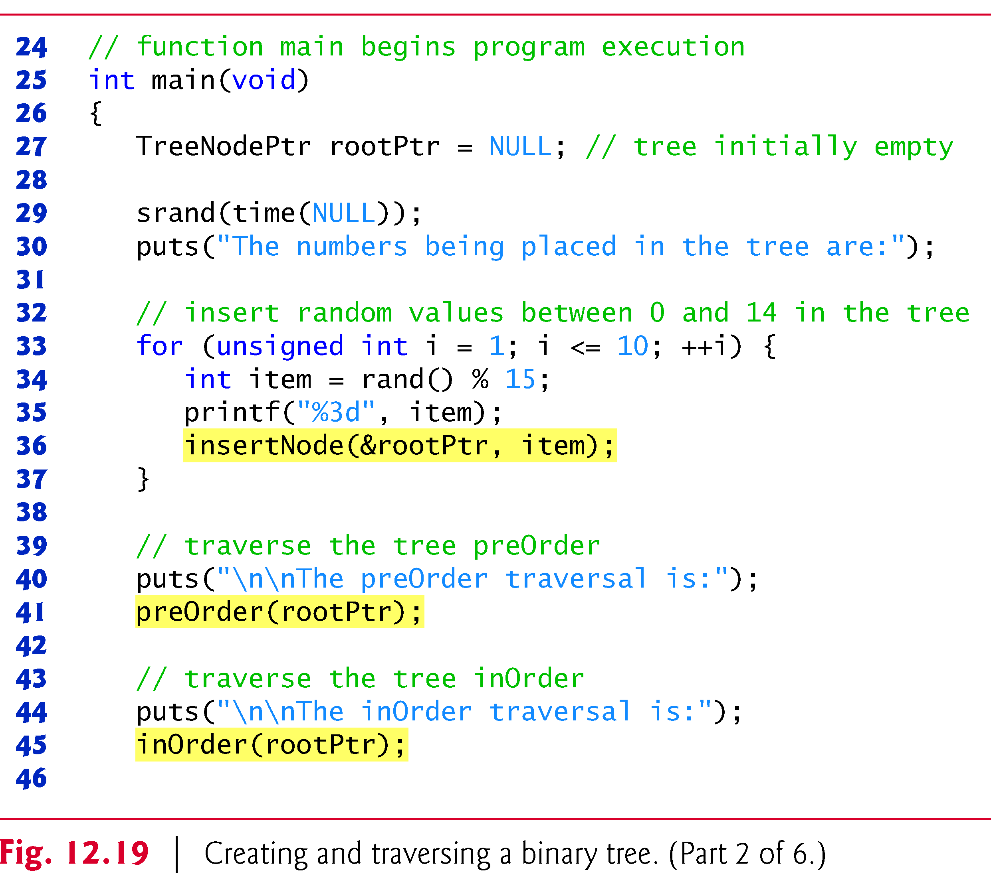

Slide 40
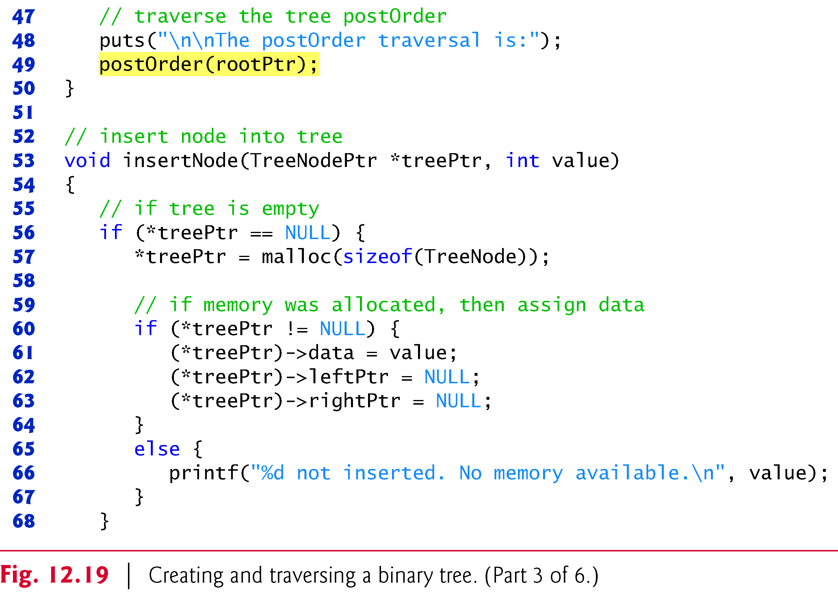
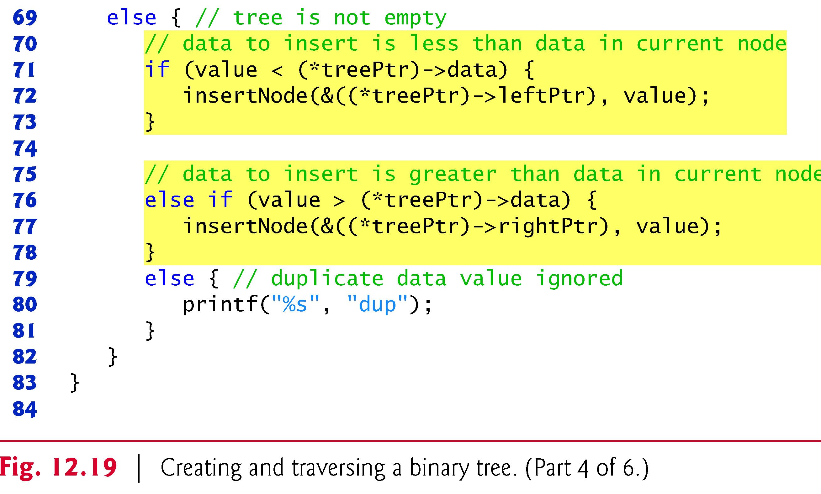

Slide 41
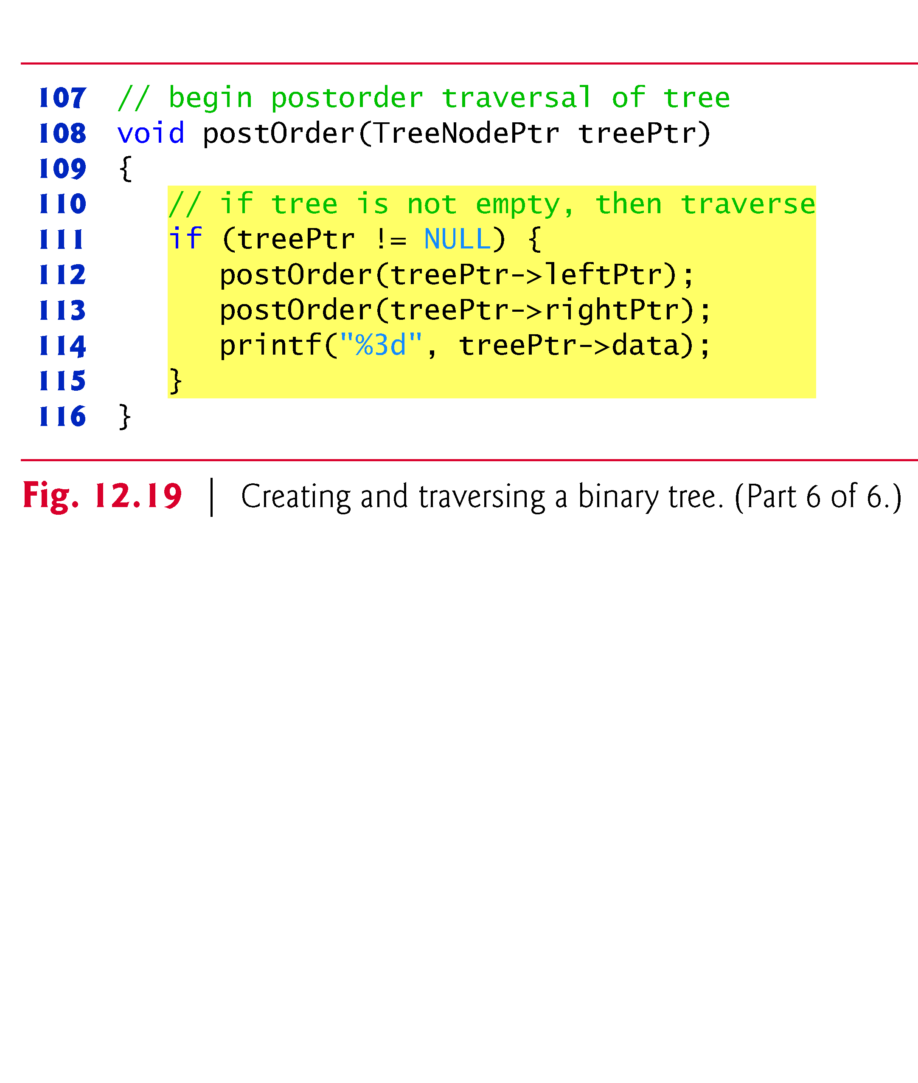
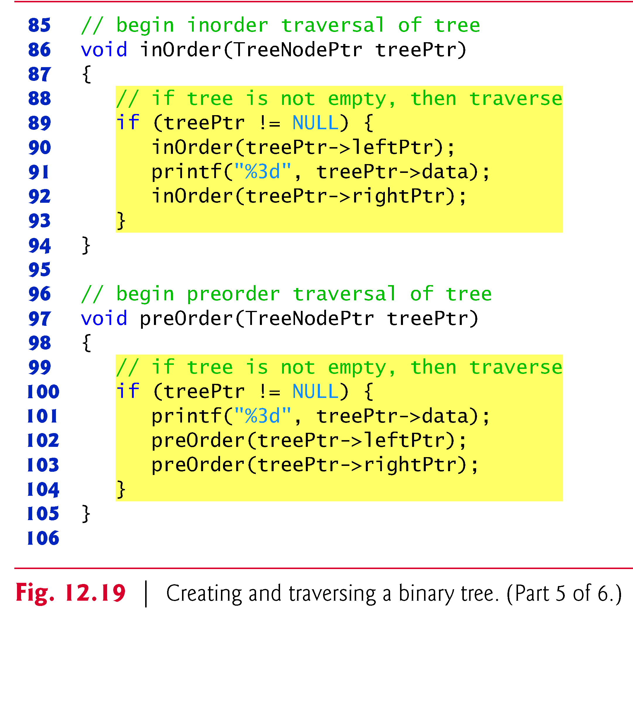

Slide 42


